Slide 1


Dr.D.Y.Patil College of Agriculture Business Management
(AFFILIATED TO MAHATMA PHULE KRISHI VIDYAPEETH RAHURI)
STUDENT PROJECT WORK
MODULE -3 INTERNSHIP / INDUSTRIAL ATTACHMENT

Slide 2
NAME:- Sawant Vrushali Shankar
REGISTRATION NO. :- ABMP-2017/63
CREDIT:- 0+10
TOPIC OF STUDY : Study of Co-operative Credit Society
TITLE OF STUDY : A Case Study on Khandala Vividh Karyakari Sahakari Seva Society Limited Khandala

Slide 3
INTRODUCTION
The Indian Co-operative Movement has earned distinction of being the largest in the world.This is true in terms of membership and Co-operative network which spread over almost all the villages in the country and the number of Co-operative Societies. In our country, there are about 5.5 lakhs of cooperative Societies with membership of more than 22crores. It covers a wide range of commercial activities and nearly 50% of them are engaged in agriculture and agriculture related matters. Nearly 70% of the Indian population being dependant on agriculture, is thus, connected with agricultural Co-operatives. Co-operatives have covered 100% of villages and 67% of rural households. Co-operative sector contributes 50% of total agricultural credit and distributes 35% of total fertilizer consumption in the Country. They are procuring 60% of total sugar-cane. They are also playing crucial role in the agro-processing sector i.e. processing of sugar-cane, milk, cotton and oil seeds etc.Dairy Co-operatives have excelled in their area of operation and have enabled India to attain top position in milk production in the world. Edible oil marketed through Co-operative channel is estimated at 50% and handloom Co-operatives account for 55% of the total out-put.
Meaning
“A agricultural co-operative credit society is to be treated as an organization of the villagers for mutual help and co-operation to meet their common economic requirements and to increase agricultural production .the idea is to relate the short-term credit which the society gives to the production plan of the farmer and to the yields he is likely to get from the loan.”

Slide 4
Agriculture co-operative credit societies as financial institution play a very important role at the grass roots level in the development of local areas. They are not only multipurpose organizations catering to the needs of 74 diverse of society, but they are also multifunctional organizations a host of activities like banking, on out supplies, marketing produce and trading in consumers goods.
Agriculture sector needs finance, short-term, medium-term, long-term loan to get better production both in the terms of quantity and quality. agricultural co-operative societies are set up for financing the short - term needs of the farmers.”
Farmers need finance for purchasing high yield varieties of seeds, fertilizers pesticides and agricultural implements. These agriculture inputs are made available through co-operative societies which are functioning level. agriculture co-operative credit societies would be crucial for satisfying the need of members in particular and the need of the general public in their respective area in general.
Agriculture co-operative societies are set up under the cooperative act and rules and their members get the limited finance from these societies .
Thus a service co-operative society is essentially an institution, which helps the members to improve their agricultural yield at a lower cost by rendering certain, needed services at their door A service society differs from a production on its own , but just helps the constituents in improving their production .
Farmers Cooperative Society is one of the types of cooperative that organized by farmers with the objective of providing more than one service to themselves. It promotes integration of economic activities such as mobilizing capital to provide credit and inputs for agricultural production to members.

Slide 5
Importance Of The Study
Societies provides short-term KCC/Crop loans to the farmers.
Societies also implements the GoI sponsored Crop Insurance Scheme from 1985.
Zero percent interest is offered on education loans and Society godown.
Co-operative societies are mainly directed towards agriculture, tiny/small scale industries and small business enterprises related with agriculture.
These societies were started with the object of providing cheap credit to the agriculturists in order to free them from the clutches of the rapacious money-lenders.
Service cooperative societies help the poor and marginal farmers with tractors, threshers etc on rent.
Service Cooperative societies help farmers by providing top quality fertilizers, seeds, insecticides, pesticides etc at reasonable price
Improve economic condition of its members and for this purpose it aims to provide facilities for better farming better business and better living as well as carry out work of common economic interest and benefit to the members.
The study provide overall information regarding the government schemes provided specially for the agriculture sector.
The project will guide the farmer regarding the government schemes available for him & provide details regarding the subsidies under various schemes for agriculture.

Slide 6
Objectives Of The Study
To study the Oganizational structure of the Khandala Vividh Karyakari Sahakari Seva Society Limited Khandala .
To evaluate the various banking and non-banking functions of Khandala Vividh Karyakari Sahakari Seva Society Limited Khandala .
To study the different types of lending practices performed in the Khandala Vividh Karyakari Sahakari Seva Society Limited Khandala .
To evaluate the financial feasibility of Khandala Vividh Karyakari Sahakari Seva Society Limited Khandala .
To study the various problems and suggest suitable policy measures for the improvement of the financial performance of Khandala Vividh Karyakari Sahakari Seva Society Limited Khandala
Reasons For Selection of Topic
To study the role of cooperative society with respect to disbursement of agriculture loan under various government schemes.
To study the various government schemes for agriculture.
To find out the satisfaction level of customers regarding loan disbursement under the kissan credit card through cooperative society.

Slide 7
Methodology
A.Meaning
“A agricultural co-operative credit society is to be treated as an organization of the villagers for mutual help and co-operation to meet their common economic requirements and to increase agricultural production .the idea is to relate the short-term credit which the society gives to the production plan of the farmer and to the yields he is likely to get from the loan.”
Village Service Co-operative Society and Urban Cooperative Banks are examples of co-operative credit society.
B. Survey :
Sr.No. | Name of Society | Registration No. | Member
1 | Bhairavnath Vividh Karyakari Sahakari Seva Society Limited Khandala | 2000 | 753
2 | Khandala Vividh Karyakari Sahakari Seva Society Limited Khandala | 7640 | 896
3 | Vividh Karyakari Sahakari Seva Society Limited Ahire | 4330 | 968

Slide 8
C. Selection Of Unit
Name :- Khandala Vividh Karyakari Sahakari Seva Society Limited Khandala .
Selected Cooperative society Located A/P-Khandala, T-Khandala, D-Satara. was selected for the purpose of study. a service co-operative society is essentially an institution, which helps the members to improve their agricultural yield at a lower cost.
D. Source of data :-
Primary data - It was collected from the secretary and clerk of the cooperative society and the manager of DCC bank by taking interviews. The data collected was related to the cooperative society.
Secondary data - For the purpose of this study, It was collected from Internet, Society books etc. The data was related to the general information of the Cooperative society.
E. Analysis Research tool –
This study is facilitated and supported by a descriptive financial analysis to explain gauge , compare and categorize the financial situation of Indian commercial banks. It looks back to the period of five years during 2009-2013 employing different financial ratios .

Slide 9
RESULT AND DISCUSSION

Slide 10
INFORMATION OF THE SOCIETY
NAME : Khandala Vividh Karyakari Sahakari Seva Society Limited Khandala
Branch : Khandala
Address : A/P.- Khandala, Tal.-Khandala, Dist.-Satara
Registration Number : 7640
Year of Establishment : 14 December 1936
Audit class : “A”
Pin code :- 412802

Slide 11
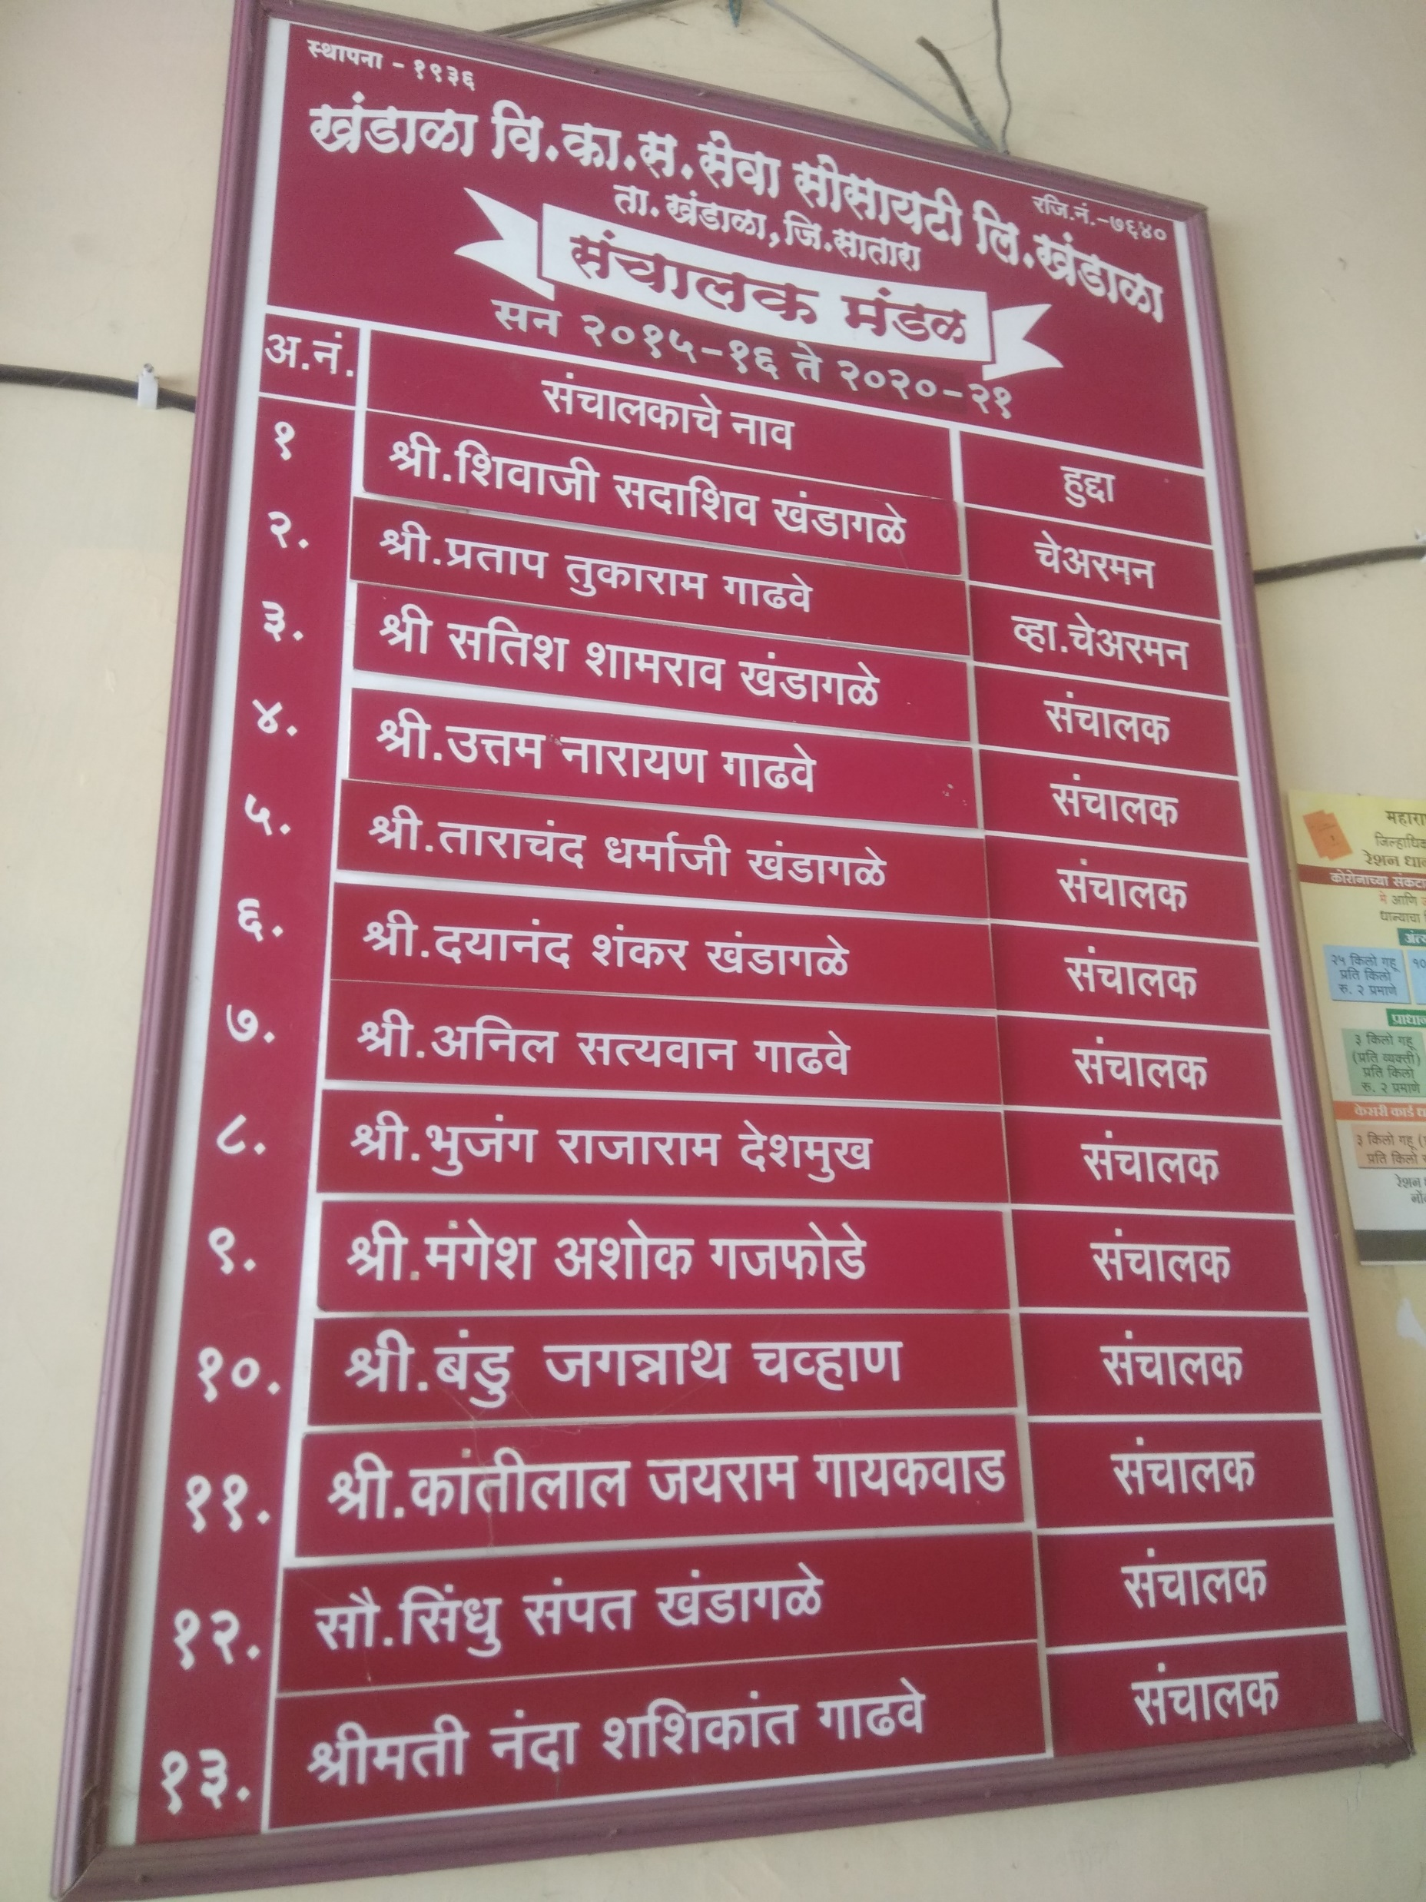
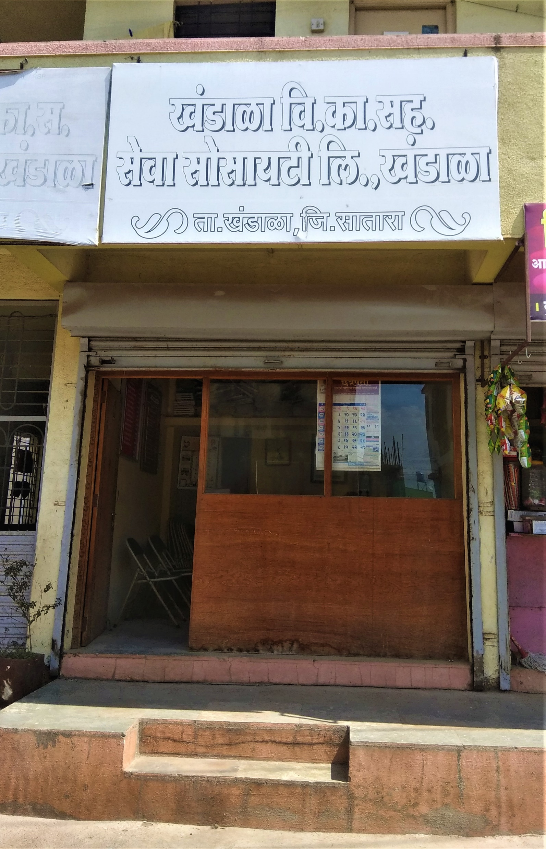

Slide 12
Organizational structure :-
The management of the Agricultural Credit Societies is same as the managements of other societies in Maharashtra on the principles of democracy. It is based on the principles, “One Member, One Vote.” The management is entrusted to two bodies- The General body and managing committee. The general structure of organization and management of Khandala Vividh Karyakari Sahakari Seva Society Limited Khandala is as follows:
General body
Management committee
Chairman-Vice chairman
Secretary

Slide 13
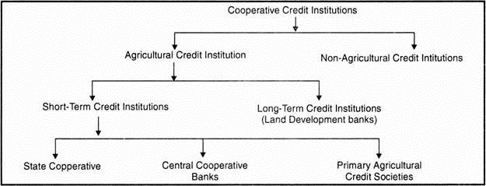
In rural India, there exists a 3-tier short-term rural cooperative structure.
Tier-I includes state cooperative banks (SCBs) at the state level.
Tier-II includes central cooperative banks (CCBs) at the district level.
Tier- III includes primary agricultural credit societies (PACSs).
The major objectives of the agricultural credit service societies are to supply agricultural credit to meet the requirements of funds for agricultural production, the distribution of essential consumer commodities, the provision of storage and marketing facilities.

Slide 14
Information of Management Committee :
Sr.No. | Number of member | Position | Age | Experience in management committee | Training | Number of meetings attended during year
1 | Shivaji S. Khandagale | Chairman | 50 | 15 | MRSS | 24
2 | Pratap T. Gadhve | Vice Chairman | 49 | 15 | MRSS | 24
3 | Satish S. Khandagale | Director | 48 | 20 | MRSS | 24
4 | Uttam N. Gadhve | Director | 54 | 10 | MRSS | 24
5 | Tarachand D. Khandagale | Director | 50 | 10 | MRSS | 24
6 | Dayanand S. Khandagale | Director | 51 | 15 | MRSS | 24
7 | Anil S. Gadhve | Director | 46 | 15 | MRSS | 24
8 | Bhujang R. Deshmukh | Director | 53 | 15 | MRSS | 24
9 | Mangesh A. Gajfode | Director | 49 | 10 | MRSS | 24
10 | Bandu J. Chavan | Director | 46 | 10 | MRSS | 24
11 | Kantilal J. Gaikwad | Director | 55 | 15 | MRSS | 24
12 | Sindhu S. Khandagale | Director | 46 | 4 | MRSS | 24
13 | Nanda S. Gadhve | Director | 45 | 4 | MRSS | 24

Slide 15
Information of Secretary :
General Information
Name of the Secretary : Pandurang Khandagale
Age : 47
Education : M.A.Bed
Experience : 15 years
Training in cooperation : MRSS
Where secretary resides at H.Q. : Yes
Number of visits per week to society : 6 days

Slide 16
INFORMATION OF STAFF :
Sr.No. | Name of the member | Position | Age | Educational Qualification | Experience
1 | Pandurang Khandagale | Secretary | 47 | MA.Bed | 15
2 | Pravin Gadhve | Clerk | 34 | BA | 8
Society is for a single village
Sr.No. | Name of village | Head quarter | Population (2011 census) | Distance from Headquarter | Number of members from the village | Borrowers
1. | Khandala | Khandala | 6832 | - | 896 | 268

Slide 17
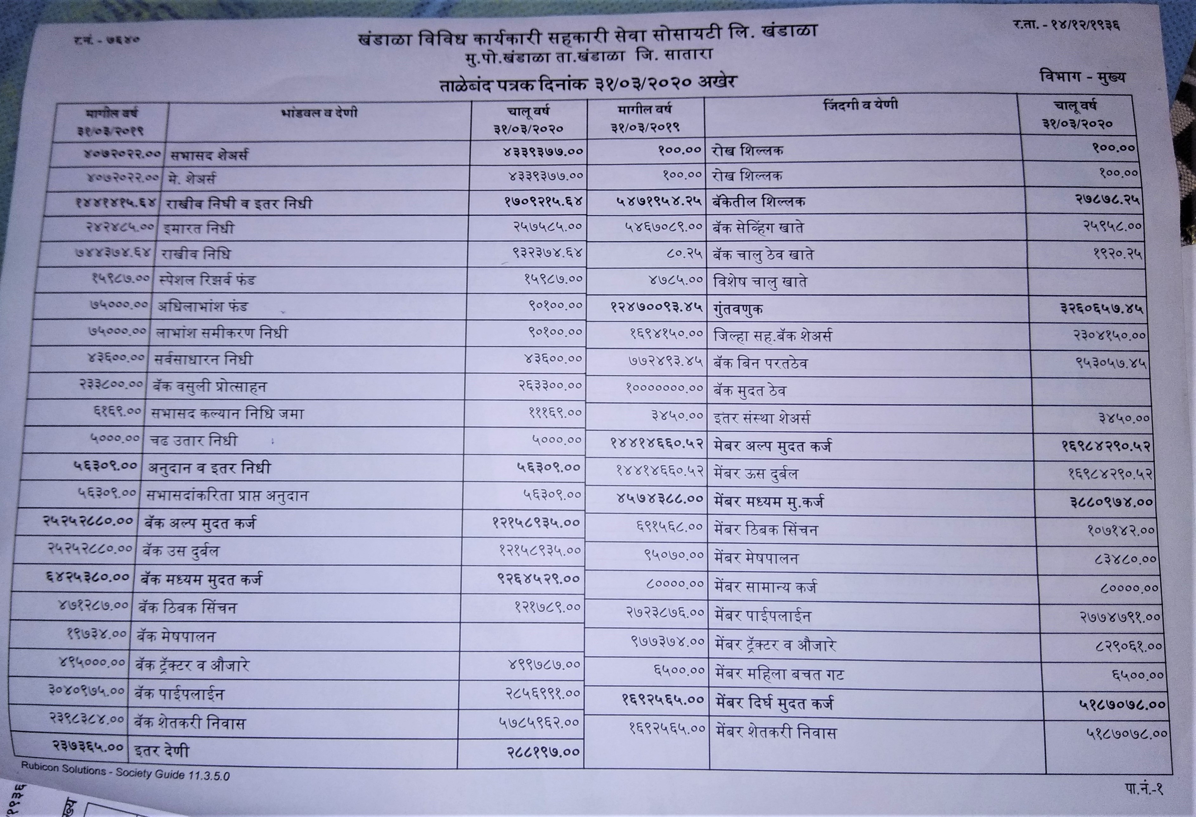
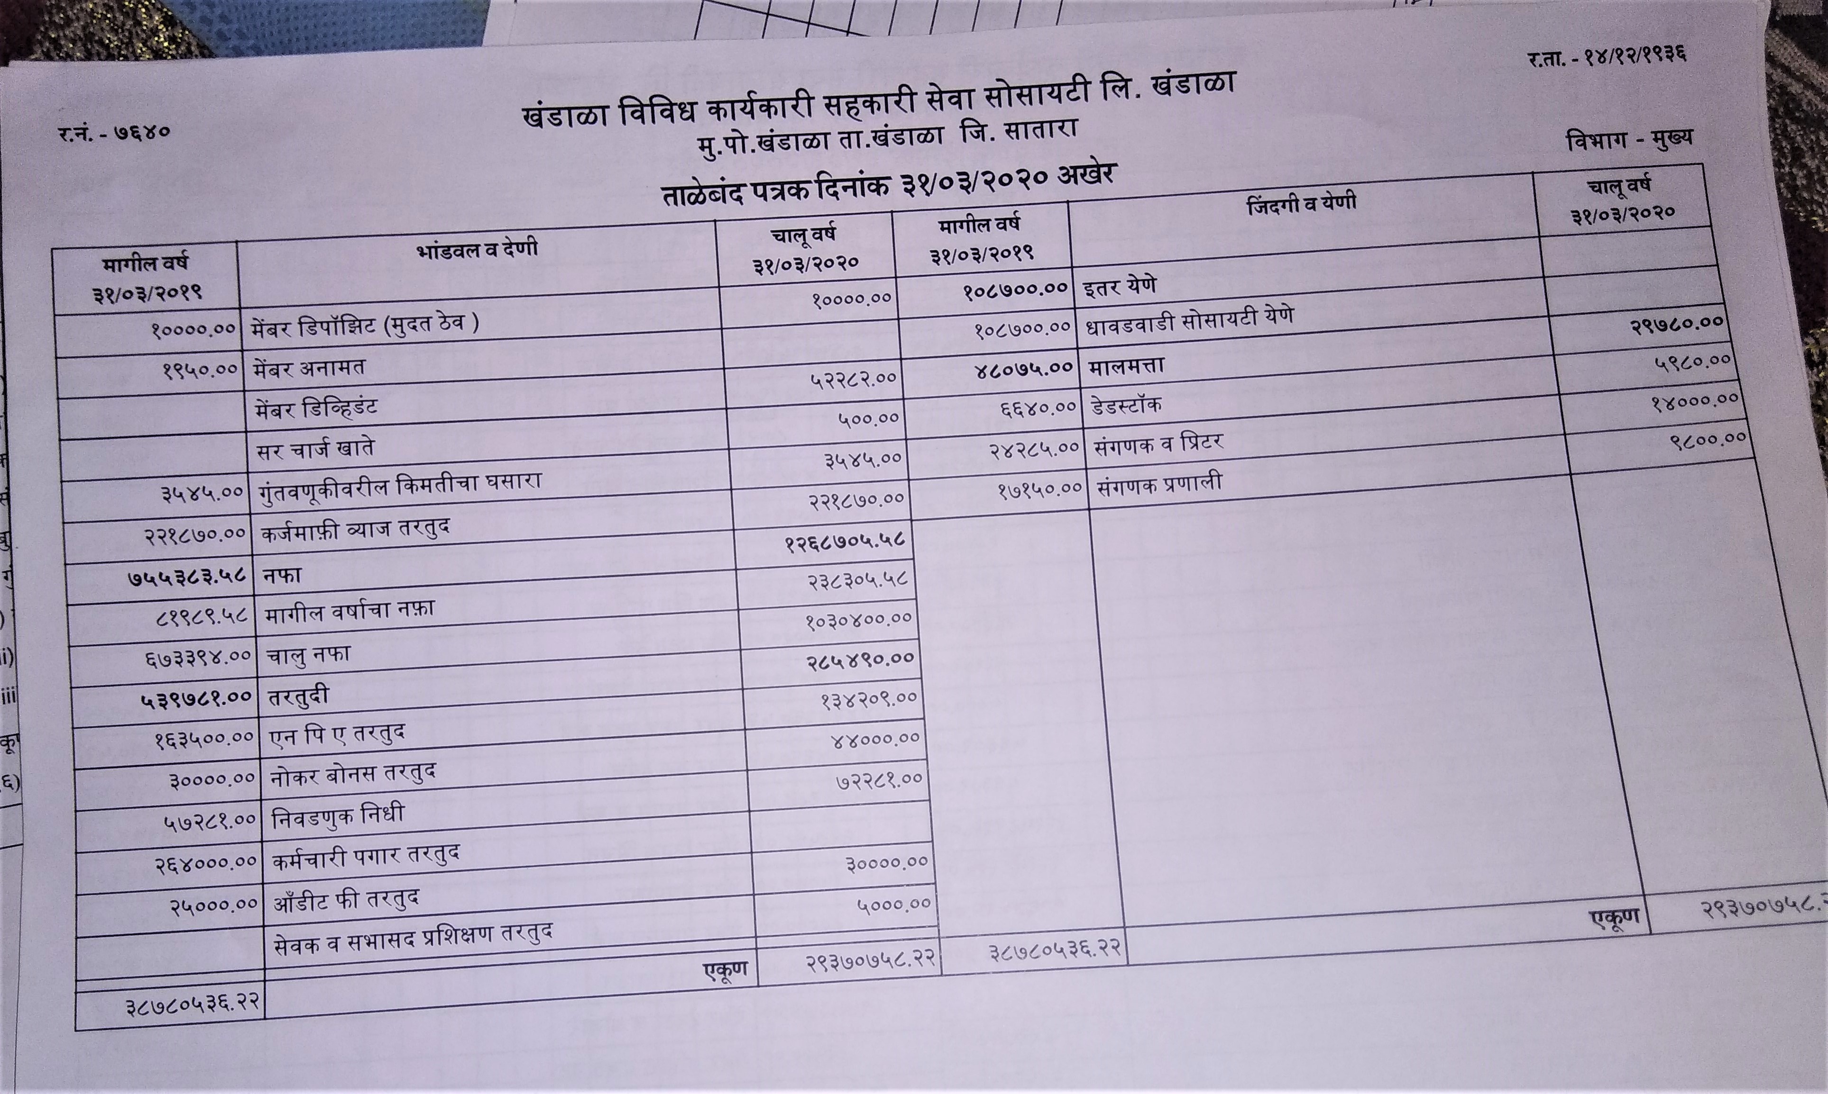
Balance Sheet of Society :-(2019-2020)

Slide 18
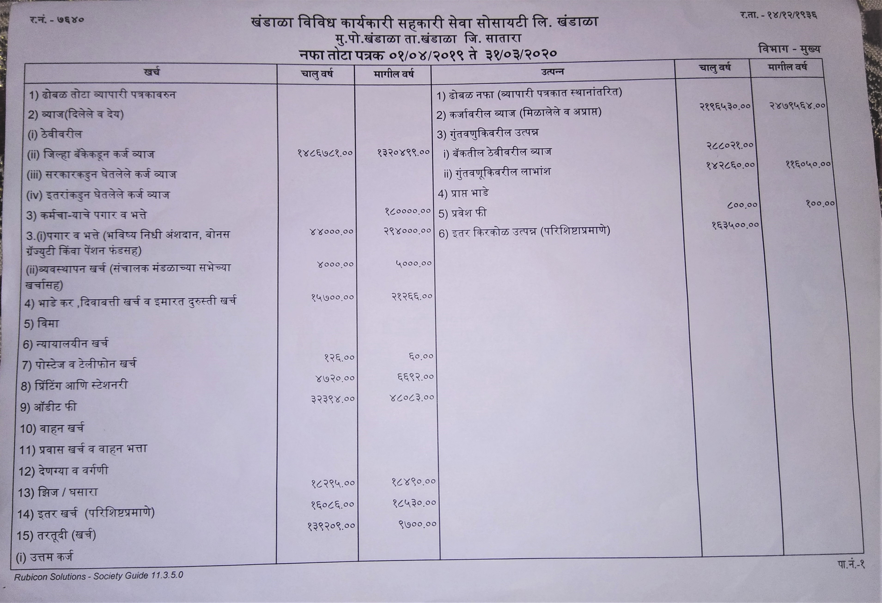
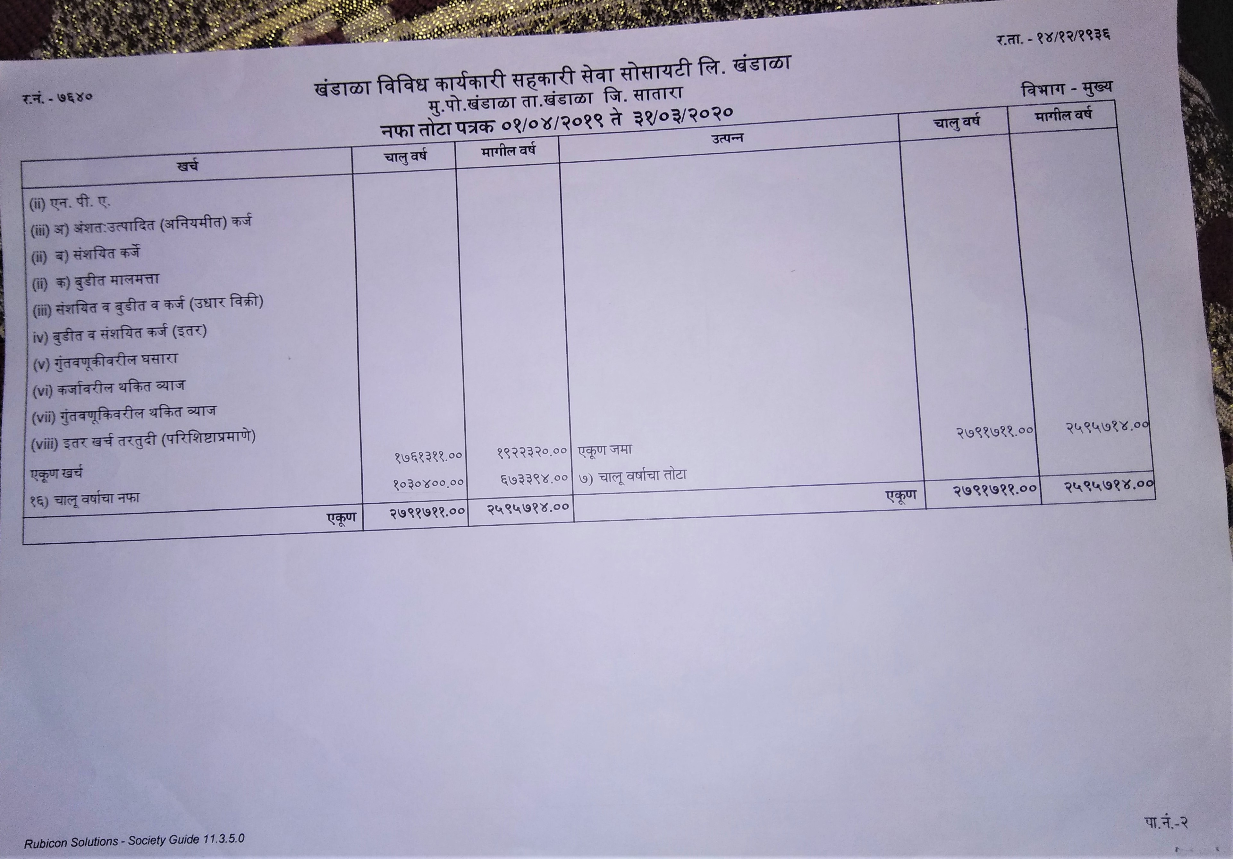
Profit-Loss of Society :- (2019-2020)

Slide 19
Capital Structure : (Source of fund)
1.Share Capital:- 43,39,377.00₹
2.Deposits :-27,878₹
Sr.No. | Share Capital | Amount(₹)
1. | Value of each Share
 | From members | 4339377
Sr.No. | Years
 | 2015-16 | 2016-17 | 2017-18 | 2018-19 | 2019-20
From members (₹ in lakh) | 9.20 | 24.23 | 89.60 | 54.71 | 0.27

Slide 20
3.Borrowings of Society :- 2,14,23,464 ₹
Sr.No. | Institution | Amount Borrowed(₹) |  | Rate of Interest(%) |  | Period of repayment(Yr.)
 |  | S.T.Loan | M.T. & L.T. Loan | S.T.Loan | M.T. & L.T. Loan | S.T.Loan | M.T. & L.T. Loan
1. | SDCC Bank Khandala | 1,21,58,935.00 | 92,64,529.00 | 4 | 10.5 | 1 | Depend on loan type

Slide 21
4.Other funds of the society :-
5. Working Capital (2019-20) :- 2,74,99,934.6₹
Sr.No. | Funds | Amount(₹) | Percentage(%)
1 | Reserve Fund | 932374.64 | 54.55
2 | Special Reserve Fund | 15987 | 0.93
3 | Divident to members | 11169 | 0.65
4 | Building Fund | 257585 | 15.07
5 | Price Fluctuation Fund | 5000 | 0.29
6 | Bonus to staff | 90100 | 5.27
7 | Any other | 397000 | 23.22
Total |  | 1709215.64 | 100

Slide 22
6. Credit Advance :-
6.A. Short Term Loan :-
Rate of Interest :-6 %
Duration :-1 Year
Purpose :-Sugarcane Crop
Sr.No. | Year | Number of Borrowers | Total Amount(₹)
1 | 2020 | 208 | 1,69,84,290.00
2 | 2019 | 186 | 1,46,25,275
Documentation :- 1)7/12
2)8 A
3)Cropping pattern
4) Map of Farm
5)KA.MA.Patrak
6) Farmer Aadhar Card Xerox.
7) Balance sheet & Profit and loss of cooperative society

Slide 23
6.B. Medium Term Loan
Rate of Interest :- 13 %
Duration :-5-7 Year
Purpose :- 1)Pipeline
Documentation :- 1)Pipeline quotation 2)7/12
3)Light bill 4) Estimate cost
5)Map of farm 6)Layout of farm
7) Cropping pattern 8) Head & hp calculation
9) Agreement 10) Silent features of scheme
11) Incremental income 12)Deed of hypothecation
13)Balance sheet & Profit and loss of cooperative society .
Sr.No. | Year | Number of Borrowers | Total Amount(₹)
1 | 2020 | 28 | 27,74,000.00

Slide 24
Purpose:-2)Drip Irrigation
Documentation :- 1)7/12
2) Light bill
3) Plan estimate
4) Drip quotation
5)Map of farm
6)Layout of farm
7)Cropping pattern
8) Agreement
9) Head & hp calculation
10) Silent features of scheme
11) Incremental income
12) Deed of hypothecation
13) Balance sheet & Profit and loss of cooperative society .
Sr.No. | Year | Number of Borrowers | Total Amount(₹)
1 | 2020 | 2 | 1,07,142.00

Slide 25
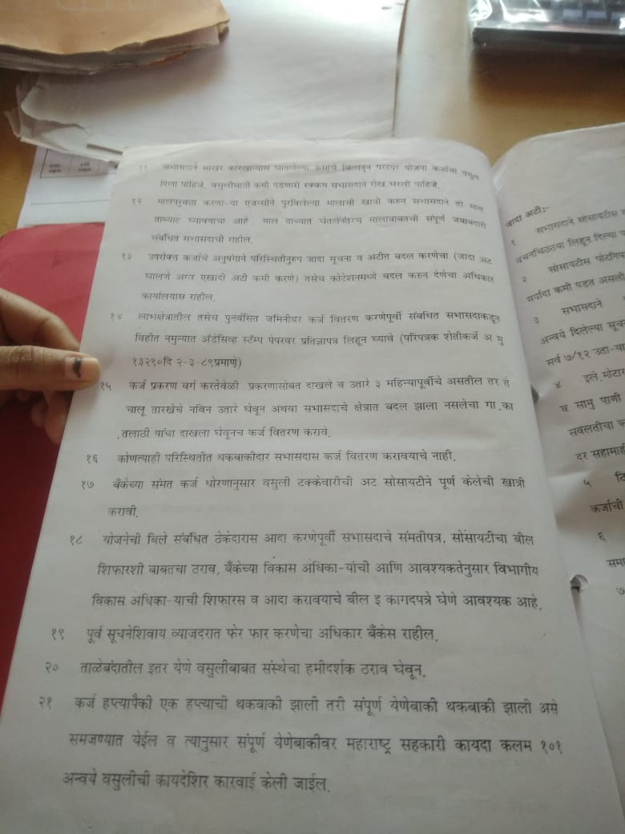
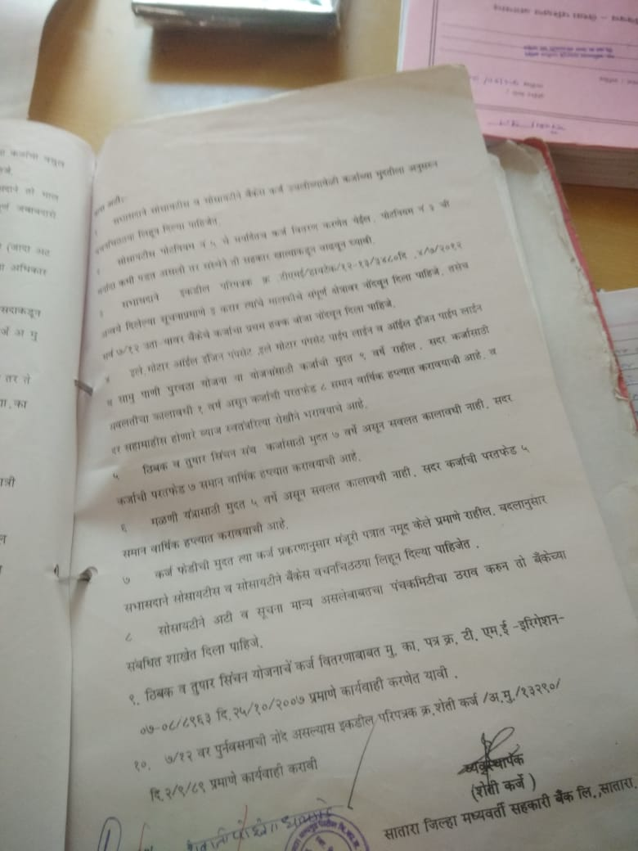
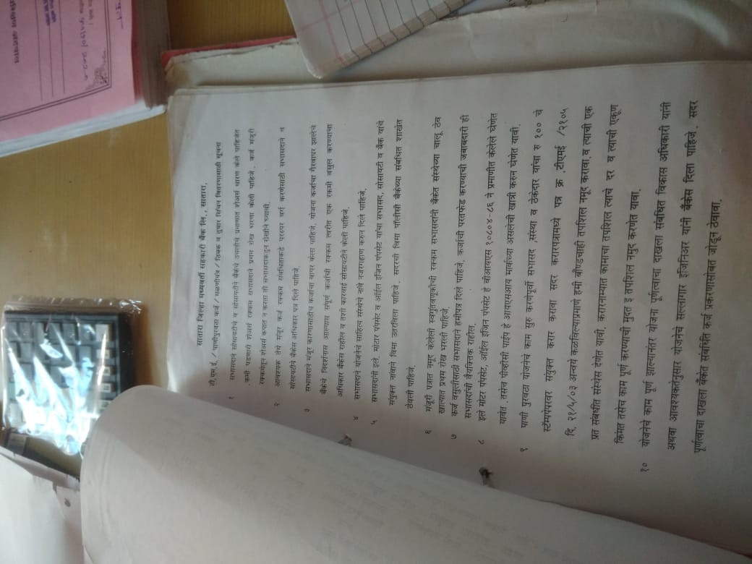
Loan Distribution Rules & Instructions For Drip Irrigation :-
Sr.No. | Member | Holding Area (Ha.) | Irrigated area | Water availability | Work should done by member | Investment Cost(₹) | Self investment(₹) | Loan Approval(₹)
1. | Nitin Chandrakant Dhaigude | 1.03 | 0.49 | Well(G.N.547) | As stated in the quotation materials should be purchased & the drip irrigation scheme should be completed within the period of 6 months. | 43,212 | 2,212 | 41,000

Slide 26
6.C. Long Term Loan
Rate of Interest :- 13 %
Duration :-15 Year
Purpose :- 1)Shetkari Niwas
Documentation :-1)7/12
2) 8 A
3) No Objection Certificate
4) Estimate Plan
5) Other Bank NOC
6) Permission letter of Grampanchayat
7) Agreement, Search Report
8)Photograph of Borrower And witness
9) Deed of hypothecation
10) Balance sheet & Profit and loss of cooperative society .
Sr.No. | Year | Number of Borrowers | Total Amount(₹)
1 | 2020 | 20 | 51,87,000.00

Slide 27
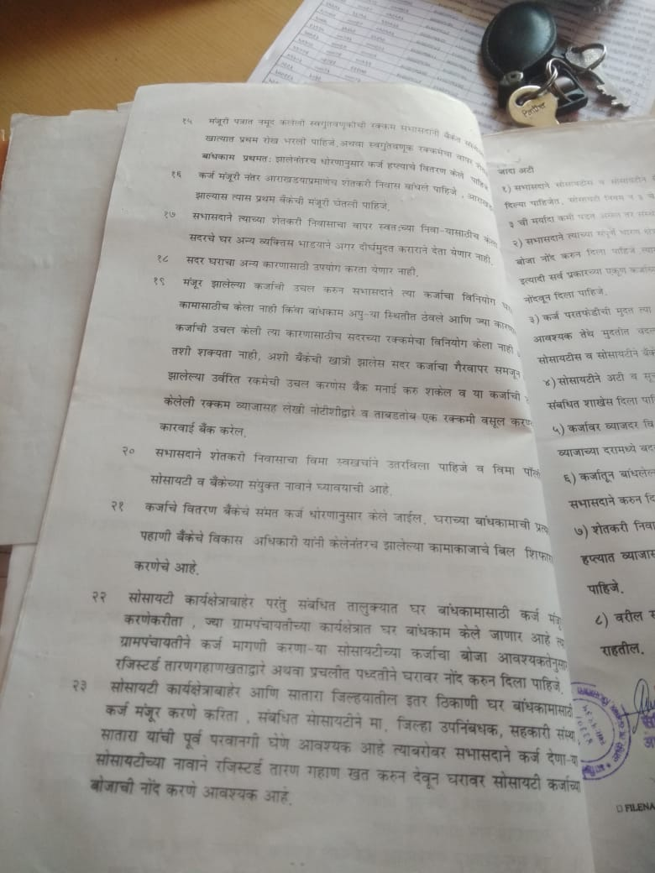
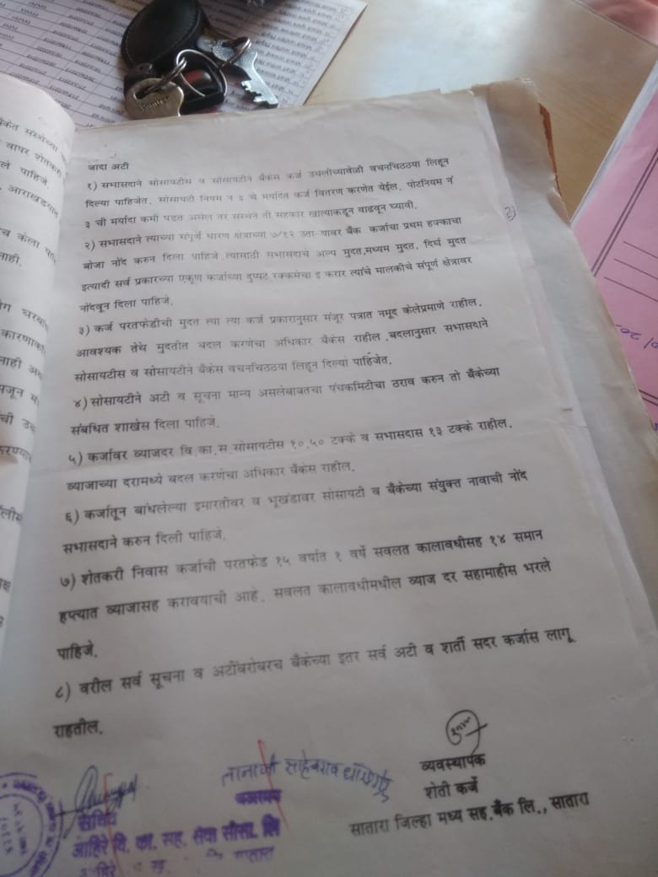
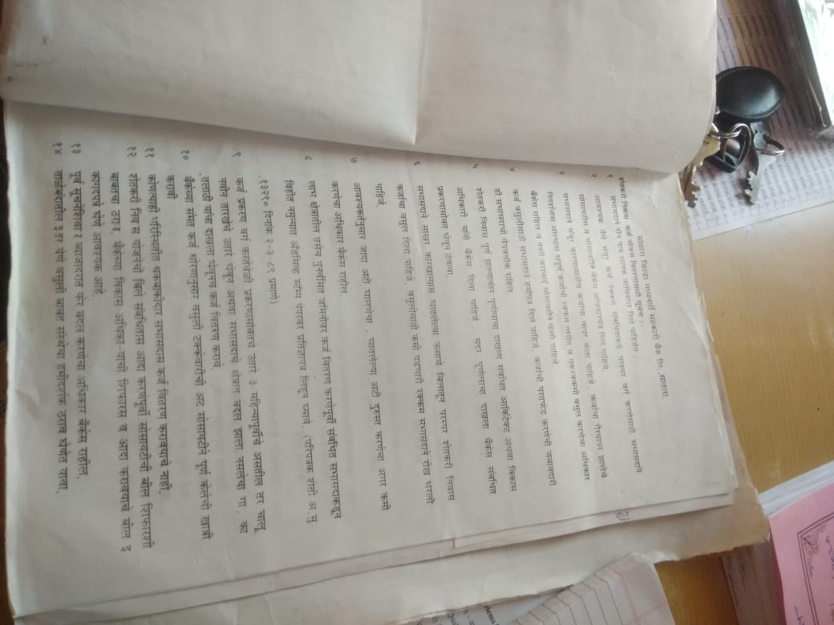
Loan Distribution Rules & Instructions For Shetkari Niwas:-
Sr.No. | Member | Holding Area (Ha.) | Required area (Ha.) | Work should done by member | Investment Cost(₹) | Self investment(₹) | Loan Approval(₹)
1. | Vitthal Buva Dhaigude | 2.78 | 2.75 | As stated in the plan M.N.602 house should be constructed along with toilet, Water & Electricity services should be completed within the period of 11 months. | 5,77,179 | 1,97,179 | 3,80,000

Slide 28
6.C. Long Term Loan
Rate of Interest :- 10.5 % (Cooperative society)
Duration :-5-9 Year
Purpose :- Tractor
Documentation :-1)Tractor quotation
2)RC Book
3) Tax invoice
4) Bond(Deed of hypothecation)
5)7/12
6) 8 A
7)Schedule of tractor
8) Silent features of scheme
9) Balance sheet & Profit and loss of cooperative society .

Slide 29
7. Overdues :
Sr.No. | Types of Loan | Amount of Overdues
 |  | 2020 | 2019 | 2018 | 2017 | 2016 | Total (₹) | Percentage
1 | Short Term Loan (₹) | 688305 | 1887850 | 1860000 | 1408000 | 501000 | 6345155 | 57.62
 | Number of Borrowers | 9 | 24 | 22 | 30 | 5 | 90
2 | Medium Term Loan (₹) | 551946 | 958394 | 695000 | 398000 | 210000 | 2813340 | 25.55
 | Number of Borrowers | 12 | 13 | 15 | 12 | 9 | 61
3 | Long Term Loan (₹) | 57189 | 35058 | 30240 | 31200 | 1700000 | 1853687 | 16.83
 | Number of Borrowers | 4 | 1 | 1 | 2 | 1 | 9
 | Total Loan Amount (₹) | 1297440 | 2881302 | 2585240 | 1837200 | 2411000 | 11012182 | 100

Slide 30
Pre-sanction appraisal proposal of crop and development loan :-
Interview with farmer and gives the information for loan.
Checking the general information of borrower ,crop and 7/12.
Total documents for the loan are verify by the authority person of society.
Documents carry the responsibility for application of loan.
After examining all the aspects presented in the presanction from inspection report.
Secretary takes decision whether sanction of loan take or not of farmer.
Before sanctioning the loan secretary and management committee take decision the farmer are feasible to taken the loan .
Secretary consider the technical feasibility repayment capacity, bank ability, risk bearing ability of farmer.
Secretary verifying the documents of borrowers before this document are forwarded to the agriculture officer of DCC bank .
The authorities person taken the all documents the verify goes on surprising visit to the borrowers land.
Before the authorities person goes on all this process gate final decision on the proposed project and communicate the bank manager .
The bank manager gives the further action of the sanction of loan.

Slide 31
Post sanction follow up of crop and development loan :-
The post sanction of the loan ,verifying the loan gives the amount of borrowers .
The secretary pays the credit and visit to the farmer land to a certain the proper investment of the loan.
These visit develop best bonding/ relationship of bankers and farmers.
When the proper utilization of the credit of crop loan.
These visit are more informal then formal of friendliness of society and farmer.
Then the farmers to repay the loan when it falls due.
These visit post sanction of the loan also facilities in assessing further requirement of supplementary credit to complete the scheme .

Slide 32
Different Type of Loans available at Society:-
Rate of interest : 13%
Sr.No.. | Name of loan | Unit Cost (₹) | Self Investment | Repayment period(year) | Installments | Mortgage Details
1 | Regular out of district buying
 | Hybrid Cow | 58000 | - | 5 | 20 | 0.15 Ha. Irrigated area or 0.20 Ha rainfed area
 | Pandharpuri buffalo | 37000 | - | 5 | 20 | 0.10 ha. Irrigated area
 | Murrah buffalo | 58000 | - | 5 | 20 | 0.15 Ha. Irrigated area or 0.20 Ha rainfed area
2 | Local district buying
 | Sheep(21) | 134000 | - | 5 | 8 | Minimum 2 acre land.
3 | Goat Farming(21) | 134000 | - | 5 | 8 | Minimum 2 acre land.
 | Sheep/Goat Farming(11) | 71500 | - | 5 | 8 | Minimum 1 acre land.
 | Sheep/Goat Farming(6) | 40000 | - | 5 | 8 | 0.20 ha land

Slide 33
Sr.No. | Name of loan | Unit Cost (₹) | Self Investment | Repayment period(year) | Installments | Mortgage Details
4 | Out of district buying
 | Hybrid Cow(5) | 290000 | - | 5 | 20 | 1 ha. Irrigated area or 1.60 Ha rainfed area
 | Murrah buffalo(5) | 290000 | - | 5 | 20 | 1 ha. Irrigated area or 1.60 Ha rainfed area
5 | Dairy entrepreneurship development scheme (Subsidy Allowed)
 | Hybrid Cow/Desi cow/Murrah buffalo(10) | 700000 | 70000 | 7 | 28 | -
6 | Central Sheep/Goat Farming (42) (Subsidy Allowed) | 100000 | 10000 | 5 | 8 | 1.20 ha. land
7 | Poultry Venture Capital Fund for Contract poultry farming(5000) (Subsidy Allowed) | 1120000 | - | 7 | 14 | -
8 | Swayam sahayata bachat gat (Subsidy Allowed) Rate of intrest- 6 % | 250000 | - | 5 | - | Group of 10-20 Below poverty line members
9 | Silk & Milksilk | 245098 | 12% | 7 | 13 | Minimum 1.20 Ha land
10 | Poultry Farm For Meat purpose(1000) | 145000 | 15% | 5 | 10 | 2 ha land

Slide 34
Sr.No. | Name of loan | Unit Cost (₹) | Self Investment | Repayment period(year) | Installments | Mortgage Details
11 | Polythene Paper | 45500(per acre) | 12% | 5 | 5 | All land
12 | Society Rural warehouse(1000M.T.) (Subsidy Allowed) | 3500 (Per ton) | 2625(Per ton) | 10 | 9 | All land
 | Personal Rural warehouse (Subsidy Allowed) | 3500 (Per ton) | 25-49% | 10 | 9 | All land
13 | Water Supply | 75000-20lakh | 5% | 9 | 8 | Irrigated & other land.
14 | Drip/Sprinkle Irrigation (Subsidy Allowed) | 50000-1lakh | 5% | 7 | 7 | -
15 | Pack House (Subsidy Allowed) | 400000 | 15-49% | 15 | 14 | All land
16 | Toilet | 14500 | 16000 | 7 | 6 | 0.30ha. Irrigated & 0.45 ha Rainfed area
17 | Shetkari Niwas | 2000000 | 15-49% | 15 | 14 | All land
18 | Thresher machine | 30000 | 15-40% | 5 | 14 | All land
19 | Onion Crop (Subsidy Allowed) |  |  | 7 | 6 | -
 | 5 Metric Tonne | 35490 | 4490 |  | 6 | -
 | 50 Metric tonne | 345000 | 35000 |  |  | -

Slide 35
Sr.No. | Name of loan | Unit Cost (₹) | Self Investment | Repayment period(year) | Installments | Mortgage Details
20 | Education loan | 20lakh | - | 9 | 10 | Irrigated 1 acre land-175000₹ Ranifed-60000₹
21 | Agri Tourism | 25 lakh | - | 9 | 8 | Irrigated 1 acre land-210000₹ Ranifed-120000₹
22 | Grape garden | 347000 | 20% | 7 | 5 | For 0.40 Ha cultivated area 0.80 ha land
23 | Sericulture | 163888 | 10% | 7 | 7 | For 0.40 Ha cultivated area 0.80 ha land
24 | Land levelling | 15000(per acre) | 20% | 7 | 6 | 0.20 Ha. Irrigated area or 0.80 Ha rainfed area
25 | Agriculture Machinery (Tractor, Trailor, Power tiller, Rotavator, Dozer ) (Subsidy Allowed) | 12 lakh | 15-50% | 9 | 18 | Irrigated 1 acre land-120000₹ Rainfed-90000 ₹
26 | Green House (Subsidy Allowed) | 377760 | 10-40% | 7 | 13 | Irrigated 1 acre land-150000₹ Rainfed-0.75 lakh₹

Slide 36
Sr.No. | Name of loan | Unit Cost (₹) | Self Investment | Repayment period(year) | Installments | Mortgage Details
27 | Kadaba kutti | 25000 | 10% | 5 | 5 | 0.40ha land & Farmer should have 3 livestocks.
28 | Spraying Pump | 23500 | 10% | 4 | 4 | 0.40 ha vegetables.
29 | Agricultural clinic | 10 lakh | 20% | 7 | 6 | Irrigated 1 acre land-75000₹ Rainfed-40000 lakh₹
30 | Tissue culture Banana | 37000 | 10% | 3 | 3 | For 0.40 Ha cultivated area 0.80 ha land
31 | Papaya | 26000 | 5% | 4 | 4 | For 0.40 Ha cultivated area 0.80 ha land
32 | Vermicompost project (Subsidy allowed) | 13000 | 10% | 7 | 7 | For 1 Ton 0.40 Ha Rainfed 0.80 ha Irrigated land
33 | Floriculture
 | Gladiolus | 170000 | 10% | 5 | 5 | Rainfed -30000₹ Irrigated-60000₹
 | Tuberose | 86360 | 10% | 6 | 6

Slide 37
Sr.No. | Name of loan | Unit Cost (₹) | Self Investment | Repayment period(year) | Installments | Mortgage Details
34 | Bird of paradise | 180200 | 10% | 9 | 6 | Rainfed -25000₹ Irrigated-50000₹
35 | Nursery | 150000 | - | 5 | Depend on nursery | For 0.40 Ha cultivated area 0.80 ha Irrigated or 1.60 rainfed land
36 | Paanmala | 100000 | 5% | 7 | 6 | For 0.40 Ha cultivated area 0.80 ha land
37 | Cashewnut Farming | 12000 | 5% | 7 | 4 | For 0.40 Ha cultivated area 0.80 ha land
38 | Rose Farming | 24000 | 5% | 7 | 6 | For 0.40 Ha cultivated area 0.80 ha land
39 | Teak wood | 22000 | 5% | 12 | 1 | For 0.40 Ha cultivated area 0.80 ha land
40 | Eucalyptus(Nilgiri) | 16000 | 5% | 10 | 1 | For 0.40 Ha cultivated area 0.80 ha land

Slide 38
Sr.No. | Name of loan | Unit Cost (₹) | Self Investment | Repayment period(year) | Installments | Mortgage Details
41 | Cold storage(25%Subsidy) | Max 75 % | 25% | 9 | 14 | Rainfed -40000₹ Irrigated-80000₹
42 | Custard Apple | 10000 | 5% | 7 | 4 | For 0.40 Ha cultivated area 0.80 ha land
43 | Tamrind | 7000 | 5% | 12 | 4 | For 0.40 Ha cultivated area 0.80 ha land
44 | Lemon | 8000 | 5% | 7 | 5 | For 0.40 Ha cultivated area 0.80 ha land
45 | Pomegranate | 15000 | 5% | 7 | 4 | For 0.40 Ha cultivated area 0.80 ha land
46 | Guava | 6000 | 5% | 7 | 4 | For 0.40 Ha cultivated area 0.80 ha land
47 | Mango | 10000 | 5% | 10 | 4 | For 0.40 Ha cultivated area 0.80 ha land

Slide 39
Sr.No. | Name of loan | Unit Cost(₹) | Self Investment | Repayment period(year) | Installments | Mortgage Details
48 | Fig | 8000 | 5% | 10 | 6 | For 0.40 Ha cultivated area 0.80 ha land
49 | Coconut | 8000 | 5% | 12 | 6 | For 0.40 Ha cultivated area 0.80 ha land
50 | Amla | 6000 | 5% | 6 | 5 | For 0.40 Ha cultivated area 0.80 ha land
51 | Turmeric Grinding Machine | 2.55 lakh | 15% | 5 | 5 | Rainfed -30000₹ Irrigated-70000₹
52 | Sugarcane cultivation machine | 360000 | 15% | 9 | 18 | Irrigated 1 acre land-120000₹ Rainfed-90000 ₹
53 | Hybrid Coconut cultivation | Depend on investment of crop | 10% | 9 | 6 | Minimum 0.10 ha land & max. 4 ha.
54 | Medicinal plant cultivation | Depend on investment of crop | 15% | Depend on Yield | 3 | For 0.40 Ha cultivated area 0.80 ha land

Slide 40
Sr.No. | Name of loan | Unit Cost (₹) | Self Investment | Repayment period(year) | Installments | Mortgage Details
55 | Well construction | 382000 | 15% | 15 | 14 | General area
56 | Flour mill | 20000 | 15-49% | 5 | 10 | 0.40 ha rainfed area
57 | Cattle breeding,Milk production, Milk processing industry & Agriallied Project For Finance | 5-50 Lakh | 15% | 9 | 17 | Irrigated 1acre land-2 lakh ₹ Ranifed-1 lakh ₹
58 | Two wheeler Loan | Max. 1.50 Lakh | 20% | 7 | 10 | 1.20 ha land
59 | Four wheeler Loan | Max.10 Lakh | 15% | 5 | 14 | Irrigated 1acre land-1.50lakh ₹ Ranifed-0.75 lakh ₹

Slide 41
Schemes operated by Institution under the auspices of Financial Institution such as NABARD:
Sr.No. | Name of scheme | Unit Cost(₹) | Self Investment | Repayment period(year)
1 | Dairy entrepreneurship development scheme (Subsidy Allowed)
 | Hybrid Cow/Desi cow/Murrah buffalo(10) | 700000 | 70000 | 7
2 | Central Sheep/Goat Farming (42) (Subsidy Allowed) | 100000 | 10000 | 5
3 | Poultry Venture Capital Fund for Contract poultry farming(5000) (Subsidy Allowed) | 1120000 | - | 7
4 | Swayam sahayata bachat gat (Subsidy Allowed) | 250000 | - | 5
5 | Society Rural warehouse(1000M.T.) (Subsidy Allowed) | 3500 (Per ton) | 2625(Per ton) | 10
 | Personal Rural warehouse (Subsidy Allowed) | 3500 (Per ton) | 25-49% | 10
6 | Drip/Sprinkle Irrigation (Subsidy Allowed) | 50000-1lakh | 5% | 7
7 | Pack House (Subsidy Allowed) | 400000 | 15-49% | 15
8 | Onion Crop (Subsidy Allowed) |  |  | 7
 | 5 Metric Tonne | 35490 | 4490
 | 50 Metric tonne | 345000 | 35000

Slide 42
Sr.No. | Name of scheme | Unit Cost(₹) | Self Investment | Repayment period(year)
9 | Agriculture Machinery (Tractor, Trailor, Power tiller, Rotavator, Dozer ) (Subsidy Allowed) | 12 lakh | 15-50% | 9
10 | Green House (Subsidy Allowed) | 377760 | 10-40% | 7
11 | Vermicompost project (Subsidy allowed) | 13000 | 10% | 7
12 | Cold storage(25%Subsidy) | Max 75 % | 25% | 9

Slide 43
Income of the society from different activities : (2019-2020)
Sr.No. | Income | Amount(₹) | Percentage
1 | Interest on loans to the members | 2196530 | 78.68
2 | Income on bank savings /investment
 | Interest | 288021 | 10.32
 | Divident | 142860 | 5.11
 | Any other | - | -
3 | Other | 164300 | 5.88
Total |  | 2791711 | 100

Slide 44
Expenditure of the Society : (2019-2020)
Sr.No. | Expenditure | Amount(₹) | Percentage
1 | Interest paid on deposits | 1486781 | 84.41
2 | Salaries/Allowances/Bonus/Gratuity/Provident Fund to staff | 44000 | 2.50
3 | Allowances to members | 4000 | 0.23
4 | Rent of building & repairing of building | 15700 | 0.89
5 | Telephone Charges | 126 | 0.007
6 | Audit fees & other fees | 32394 | 1.83
7 | Stationery, printing, advertisement etc. | 4720 | 0.27
8 | Any other | 16086 | 0.91
9 | Depreciation | 18295 | 1.03
10 | Provision | 139209 | 7.90
Total |  | 1761311 | 100

Slide 45
Progress of Society :
Years | Members | Share Capital (in lakh) ₹ | Reserve Fund & Other Funds (in lakh) ₹ | Borrowings (in lakh) ₹ | Loan (in lakh) ₹ |  | Overdues (in lakh) ₹ |  |  | Total turnover(in lakh) ₹ | Net profit (in lakh) ₹ | Net loss | Audit class
 |  |  |  |  | S.T. | M.T.& L.T. | S.T. | M.T. | L.T.
2020 | 896 | 43.39 | 17.09 | 214.23 | 121.58 | 92.64 | 6.88 | 5.51 | 0.57 | 293.70 | 12.68 | - | A
2019 | 883 | 40.72 | 14.41 | 316.78 | 252.52 | 64.25 | 18.87 | 9.58 | 0.35 | 387.80 | 7.55 | - | A
2018 | 872 | 37.68 | 14.12 | 243.74 | 190.29 | 53.45 | 18.60 | 6.95 | 0.3024 | 301.70 | 0.81 | - | B
2017 | 861 | 34.61 | 12.51 | 264.52 | 213.42 | 51.10 | 14.08 | 3.98 | 0.312 | 320.93 | 2.68 | - | A
2016 | 859 | 32.80 | 11.18 | 226.58 | 170.94 | 55.63 | 5.01 | 2.10 | 17.00 | 279.46 | 3.87 | - | A

Slide 46
Share Capital :-

Slide 47
Reserve Fund & Other Funds:-

Slide 48
Borrowings :-

Slide 49
Loan :-

Slide 50
Overdues :-

Slide 51
Total Turnover :-

Slide 52
Net Profit :-

Slide 53
PROBLEM & SUGGESTIONS :-
Sr.no. | Item | Problem | Suggestion
1 | Capital | No adequate capital to society | Government should provide adequate capital to society.
2 | Transport communication | Society do not have their own vehicle | Society should buy their own vehicle for transportation.
3 | Area of operation | Due to less staff member & large area of operation society can’t work properly. | Society should increase their staff members.
4 | Response from member | They are unaware about different schemes provided by governments | Managing committee and staff members provide proper information about different schemes.
5 | Managing committee | Most of the members of society are not known about Schemes & policies and management. | Educate the members about different policies & schemes.

Slide 54
Summary and Conclusion :-
Society has share capital amount is about 43,39,377 ₹ .
Society has provided loan amount of 2,14,23,464 ₹ for various agricultural loan schemes .
It was found during the study of co-operative society that it is operating various government schemes related to agricultural credit.
Society is also struggling for getting repayments of previous year loan.
The amount of overdues for previous year loan is about 12,97,440 ₹.
Society has given all the necessary information related with agricultural loan.

Slide 55
Experience Gained :-
Learnt the basics of how to manage or working process of society .
Learnt how to help customers or farmers also how to interact with them.
Learnt how to apply theoretical knowledge into practical one .
Learnt about different schemes and policies of government provided for farmer.

Slide 56
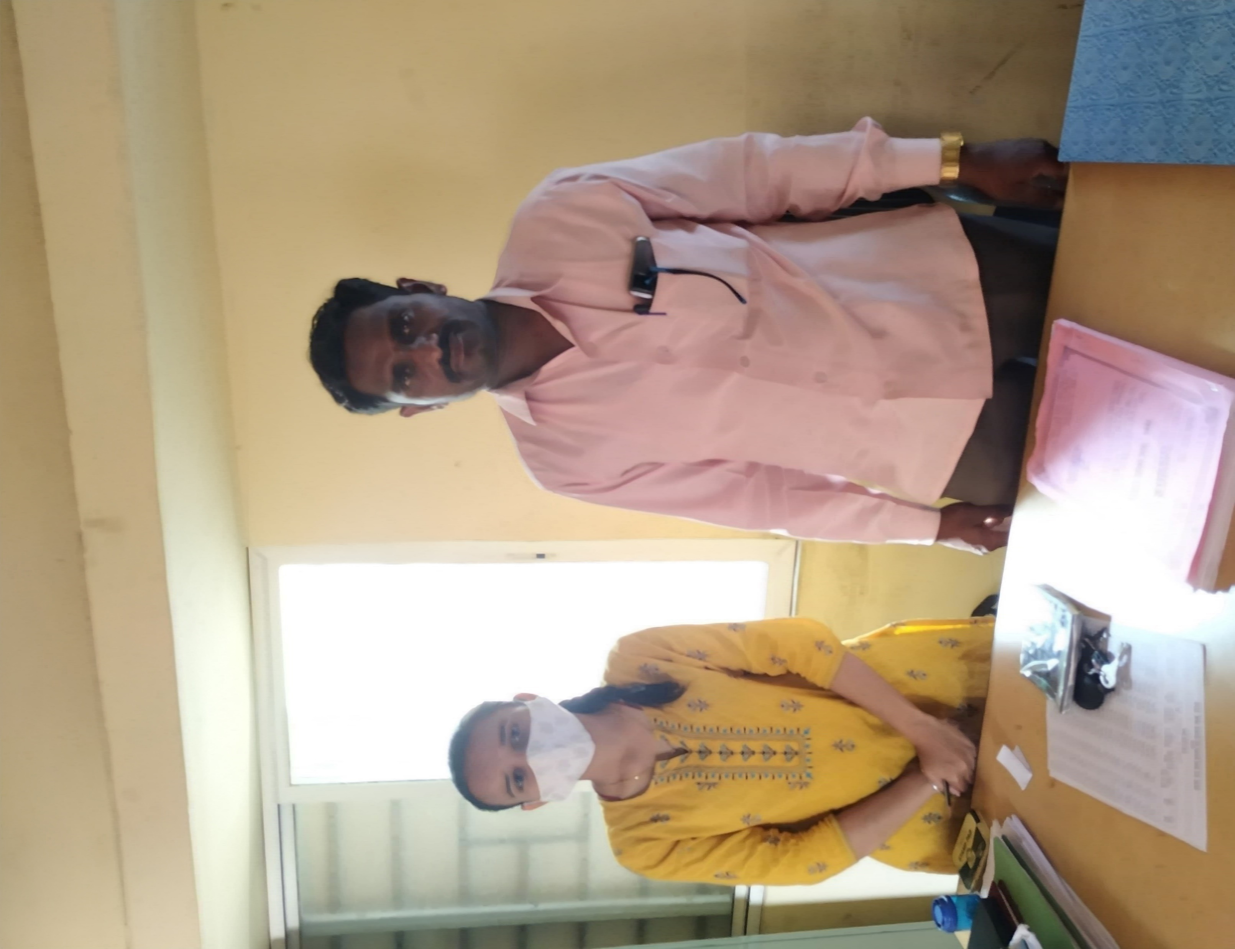
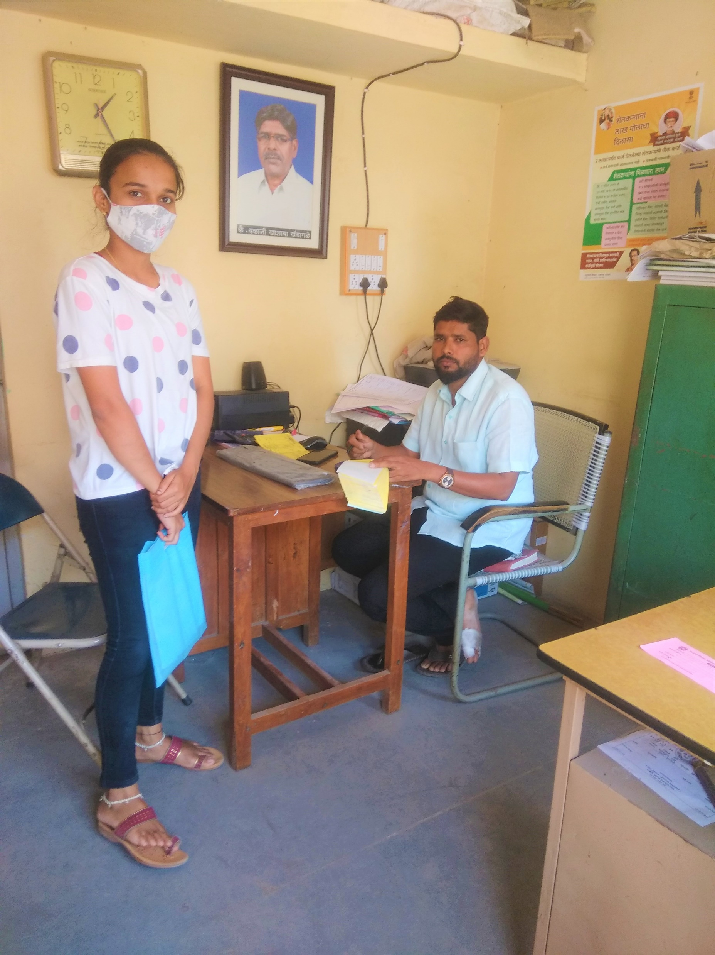
VISIT TO THE SOCIETY

Slide 57
Dr.D.Y.Patil College of
Agriculture Business Management
(AFFILIATED TO MAHATMA PHULE KRISHI VIDYAPEETH RAHURI)
STUDENT PROJECT WORK
MODULE -4 RURAL DEVELOPMENT CONSULTANCY SERVICES
NAME:-Sawant Vrushali Shankar
REGISTRATION NO.:- ABMP-2017/63
CREDIT:-0+4

Slide 58
Introduction :
An industry can run with ulmost efficiency only when different departments work together collectively. The agricultural consultancy services is the one who helps in collaborating with different people and organization relating to the agricultural industry. There are many industries which highly depend on farm and agricultural products for their own functioning. The agriculture consultants can make sure that the industry works in a proper manner ensuring that the raw material of the best quality is available to the industry at all times.
As it is evident, the agriculture industry is one of the primary and the most important industry for every economy. An agriculture consultancy services can help in many ways to improve the yield of the farmers.
The agro-service centres are located in various regions, almost all the states of India in the name of Nodal training centre.
The project is aimed at ensuring efficiency of agricultural extension activities and production methods.
The focus would be on mechanisation of farming, promotion of group farming, and encouraging the youth to take to agriculture .
To be registered under the Charitable Societies Act, the centres will also provide technical advice and agromet information to farmers.
These centres are for 'small farmers', who cannot afford 'bullocks or other farm machinery', to hire service of 'agro service centre', to make readily available various farm machinery at one place as single window.
The Department of Agriculture is setting up a network of agro service centres to provide labour support, planting material, fertilizers, and organic pesticides to farmers.
Agro-service centers promoted by MAVIM are doing well and being a form of collective, have helped farmer’s in reducing the cost of operation and increasing their bargaining power in the market. The study concludes that with small changes in the design and structure of the intervention, the organization can help them in achieving their objectives.

Slide 59
What is Agricultural Consultancy Services?
Agricultural consultancy Services is designed to support established and growing farmers, as well as anyone in the agricultural business. It helps to discover the farming needs and progress rate of a specific region, developing its agricultural sector in the process.
Who is an Agricultural Consultant?
An Agricultural consultant is an expert adviser and professional problem-solver, mostly employed by businesses in the agricultural sector. He/she advises on everything involving the ownership and occupation of land and rural businesses.

Slide 60
Responsibilities of an Agricultural Consultant.
Research is a big part of Agricultural Consultancy. As a consultant, it is important to know the latest and relevant developments in the agricultural sector. Your responsibilities will include providing insights on technical and business matters in areas such as Agronomy, Livestock, Nutrition, Waste Management, Environment, and Conservation.
You will also:
Pay visits to clients/farmer so you can evaluate and identify the business or technical issues.
Aid clients in the areas of business planning, government grant applications, legal advice, and new business opportunities.
Gather data, analyze them, and create reports that measure the performance of the agricultural enterprise.
Perform routine checks on the business and operating plans to determine where they are lacking so that you can improve them.
Organize field tests and trials to determine the solutions that the clients have.
Organize training, demonstrations, and put up presentations for clients, partners, and other stakeholders.
Write advisory leaflets, technical notes and possibly press releases and articles.
Promote your services to get new clients as well as maintain a good relationship with existing ones.
Perform administrative tasks like managing budgets and accounts, and updating the business information and preparing reports.

Slide 61
Skills of an Agricultural Consultant
Agricultural Consultant have the practical experience and extensive knowledge of farm management.
Excellent communication skills (written and spoken). This helps to establish and maintain relationships with Farmer.
Agricultural Consultants must possess persuasive skills to influence clients or farmers decisions.
Good business acumen .
Marketing, advisory, and negotiation skills to help for create new business opportunities and build client base.
Technical and analytical abilities, as well as the skills to explain findings clearly.
Need excellent organizational and time management skills. This includes attention to details and record-keeping accuracy.
Agricultural Consultants usually have financial skills for commercial awareness and budget management.
It is ideal to be a team player as well as an individual that can work without supervision.

Slide 62
Importance
Increasing cropping intensity and additional employment generation at farmers level.
Increasing utilization efficiency of costly inputs (seeds, chemical fertilisers, irrigation water) thus reducing unit cost of produce.
Increasing production, productivity and profitability in agriculture by achieving timeliness in farm operations.
The Department of Agriculture is setting up a network of agro service centres to provide labour support, planting material, fertilizers, and organic pesticides to farmers.
Employment generation through setting up of agro clinics on farm machinery.

Slide 63
Objectives of Study :
To study the consultancy services of Krushiraaj Agro-service Centre.
To study the cost and return structure of Krushiraaj Agro-service Centre .
To study the SWOT of Krushiraaj Agro-service Centre .
To identify the various problems and give suitable suggestion to Krushiraaj Agro-service Centre .

Slide 64
Methodology:-
Selection of Unit:-
Krushiraaj Agro-service Centre developed over area of having different agro-service centre units which provide us various opportunity of learning.
Address:- A/P-Paragaon, T-Khandala, D-Satara P.C.-412802
2. Collection of Data:-
Primary Data:- Direct Interview through a well designed questionnaire with owner of agro-service centre.
Secondary Data:- For the purpose of this study, data was collected from Internet, Newspaper etc.

Slide 65
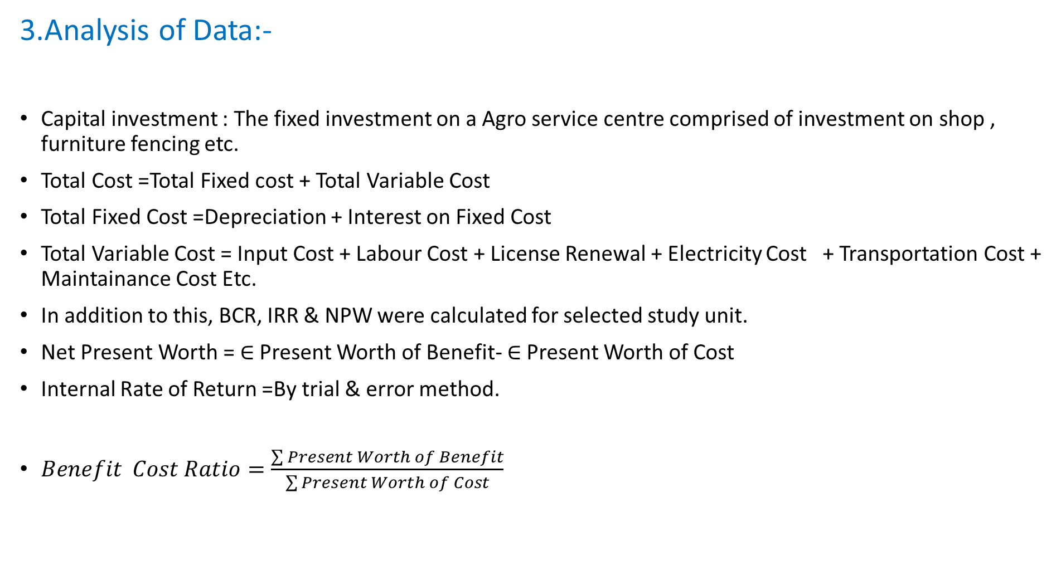
3.Analysis of Data:-
Capital investment : The fixed investment on a Agro service centre comprised of investment on shop , furniture fencing etc.
Total Cost =Total Fixed cost + Total Variable Cost
Total Fixed Cost =Depreciation + Interest on Fixed Cost
Total Variable Cost = Input Cost + Labour Cost + License Renewal + Electricity Cost + Transportation Cost + Maintainance Cost Etc.
In addition to this, BCR, IRR & NPW were calculated for selected study unit.
Net Present Worth =$∈$ Present Worth of Benefit- $∈$Present Worth of Cost
Internal Rate of Return =By trial & error method.
$Benefit Cost Ratio=\frac{\sum{Present Worth of Benefit}}{\sum{Present Worth of Cost}}$

Slide 66




Demographic Profile of Entrepreneur :
Name of Agro service centre : Krushiraaj Agro-service Centre , Paragaon.
Name of Owner :- Rajendra Ramchandra Patne
Age : 49
Education : BSC Agri
License No. : Seed:- LASD12090064
Fertilizer :- LAFD12090076
Insecticide :- LAID12090044
Products :
Seed :-

Slide 67
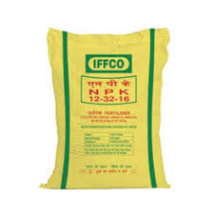
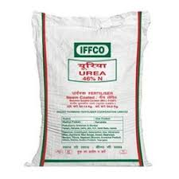
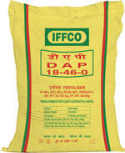

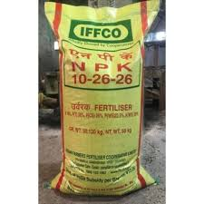

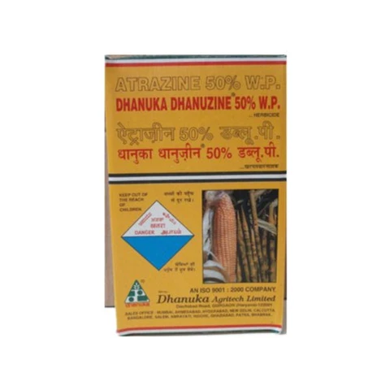


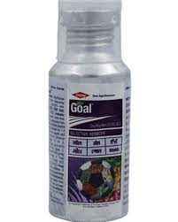

2. Fertilizer :-
3. Herbicide :-

Slide 68

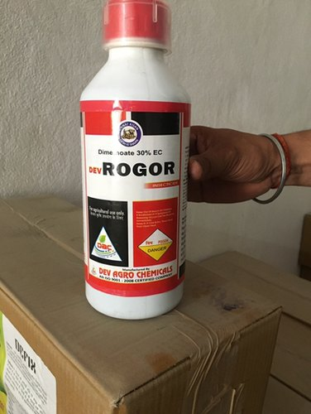
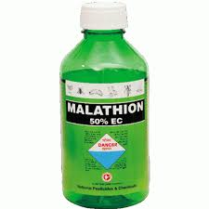
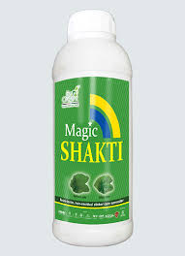


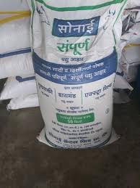
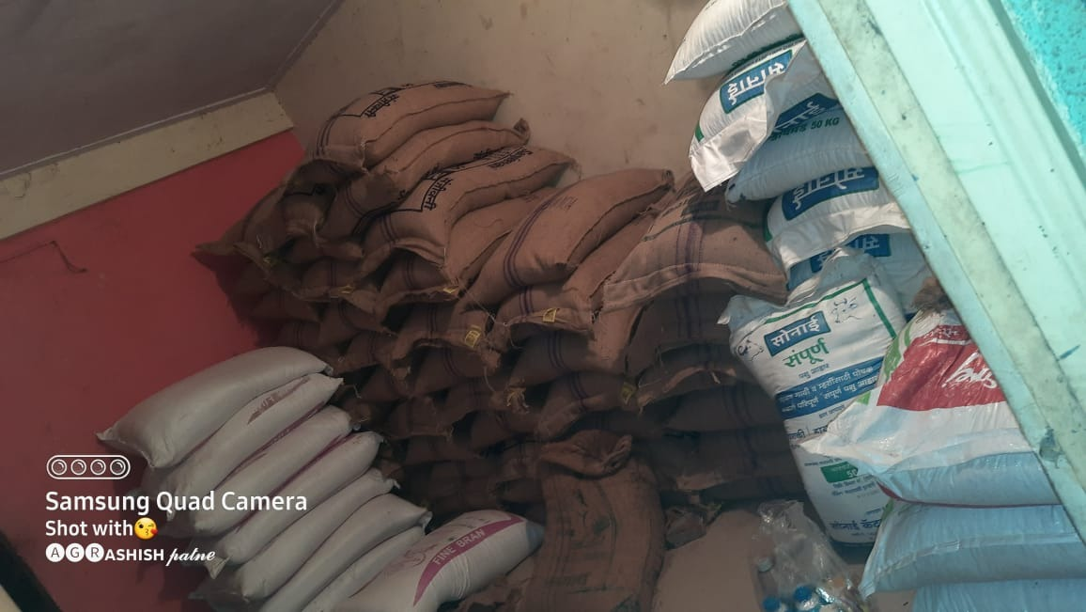
3. Insecticide :-
4. Cattle feed :-

Slide 69
Adoption Behaviour
Point consider in selecting location,
Availability of Land.
Accessible to main road .
Availability of water and electricity.
Anchored at main market.
To study the various factors related to Rural consultancy services.
To find out the satisfaction level of farmers regarding Rural Consultancy services .

Slide 70
RESULT & DISCUSSION

Slide 71
General Information :-
1 | Name of Industry | Krushiraaj Agro service Centre
2 | Address | A/P-Paragaon, T-Khandala, D-Satara P.C.-412802
3 | Name of Owner | Rajendra Ramchandra Patne
4 | Age of Owner | 49
5 | Education | BSC Agri
6 | Customer Care No. | 18001801551
7 | Email address | rahulpatne7156@gmail.com
8 | Type of Ownership | Individual
9 | Year of establishment | 1995
 | License number | Seed:- LASD12090064
 |  | Fertilizer :- LAFD12090076
10 |  | Insecticide :- LAID12090044
11 | Working days | Sunday-Friday
12 | Working Time | 8 A.M. – 8 P.M.

Slide 72
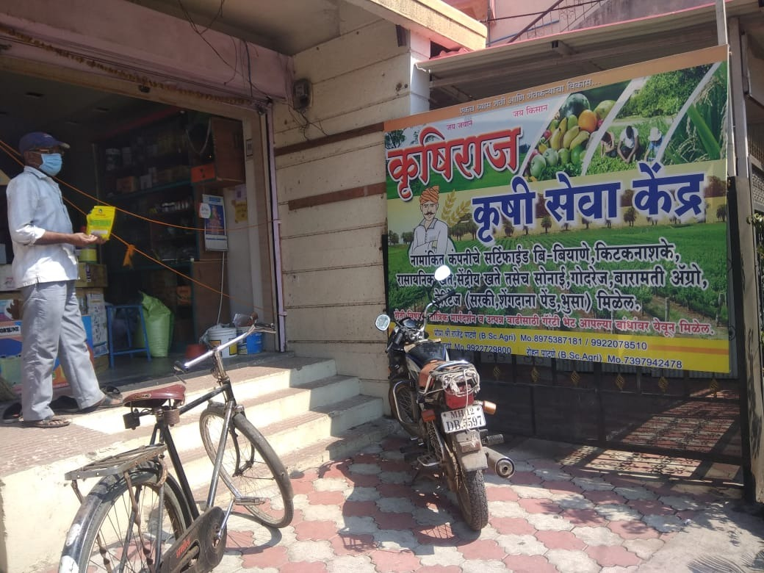
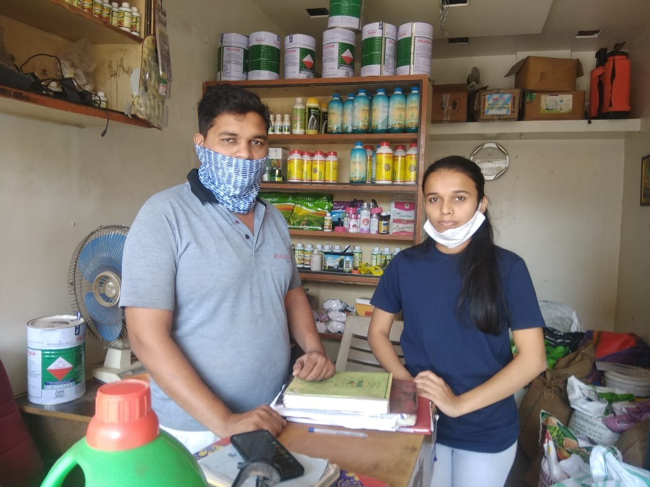
Visit to the Agro-service Centre :

Slide 73
Document Required for starting Agro service centre :-
Photo identity : Aadhar card / Pan card
Address proof : Rent receipt / Telephone bill / Electricity bill
Type of business document
Qualification Certificate
Principle Certificate
License from agriculture department
Grampanchayat NOC
Agreement with Shop (Min.10 Yrs)

Slide 74
Consultancy services provided :-
Consultant provide advice to the farmer according to their issues or problems and also undertake control operations at reasonable rate for customers.
Insect pest management
Nutrient management
Supply of inputs
Cultivation of different crops
Market information
Sr.no. | Crop | Problem | Advice
1 | Groundnut | late leaf spot & Rust disease | Spraying of (25 gm Mancozeb + 25 gm Bavistin + 10 lit. of water) mixture.
2 | Bajara | Seed treatment | Mixing 25 gm azospirillum biofertilizer / kg of seed before sowing.
 |  | Fertilizer dose | At the time of sowing -25:25:25Kg NPK/ ha. After 30days – 25 Kg N/ha
 |  | Gosavi disease | Spraying of (Metalaxyl + Mancozeb 72 WP 4gm + 10 lit water ) mixture 1-2 times.

Slide 75
Product Mix :
Seed :
Fertilizer :
Sr.No. | Seeds | Company
1 | Cereals | Mahabeej , Parik , Nirmal
2 | Vegetable | Mahabeej , Deepak
3 | Oilseed | Aditya
4 | Pulses | Mahabeej , Parik
Sr.No. | Fertilizers | Company
1 | Micronutrient | IFFCO , Narmada , RCR
2 | Water soluble | Pradip
3 | Complex | IFFCO

Slide 76
3. Herbicide:
4. Water Soluble :
Sr.No. | Particulars | Company
1 | 2-4-D | Adama , Vister , Godrej
2 | Oxoflorene | Dow
3 | Atrazin | Dhanuka, Tata ralyz
Sr.No. | Particulars | Company
1 | 19:19:19 | Pradip
2 | 12:32:16 | Trubhko
3 | 13:0:45 | Mahafeed
4 | 13:40:13 | Mahafeed
5 | 0:0:50 | Mahafeed

Slide 77
Cost & Return Structure :

Slide 78
Initial Capital Investment :-
Sr.No. | Particulars | Present Value | Percentage
1 | Deposit for shop | 50000 | 2.84
2 | Deposit for Godown | 40000 | 2.27
3 | Transport Vehicle | 850000 | 48.42
4 | Computer | 15000 | 0.85
5 | Calculator | 300 | 0.002
6 | Vehicles
 | Pickup | 800000 | 45.57
Total |  | 1755300 | 100

Slide 79
Operation Cost :-
Sr.No. | Particulars | Amount | Percentage
1 | ASC license renewal fee | 10000 | 0.27
2 | Input Cost
 | Seed | 950000 | 25.20
 | Fertilizer | 585000 | 15.52
 | Pesticide&Insecticide | 200000 | 5.31
 | Tonic | 55000 | 1.45
 | Water solubles | 115000 | 3.05
 | Herbicide/Weedicide | 220000 | 5.84
 | Cattle feed | 1000000 | 26.52
3 | Rent Charges | 240000 | 6.36
4 | Labour Charges | 120000 | 3.18
5 | Electricity charges | 6000 | 0.15
6 | Transportation charges | 250000 | 6.63
7 | Advertisement charges | 10000 | 0.27
8 | Stationary cost | 10000 | 0.27
 | Repair & maintenance | 8000 | 0.21
Total |  | 3770000 | 100

Slide 80
Annual Sales during 2020 :-
Sr.No. | Inputs | Amount | Percentage
1 | Seeds | 950000 | 30.4
2 | Fertilizers | 585000 | 18.72
3 | Pesticides & Insecticide | 200000 | 6.4
4 | Tonic | 55000 | 1.76
5 | Water solubles | 115000 | 3.68
6 | Herbicide & Weedicide | 220000 | 7.04
7 | Cattle feed | 1000000 | 32
Total |  | 3125000 | 100

Slide 81
Fixed Cost :-
Sr.No. | Particulars | Amount | Percentage
1 | Fixed Cost | 1755300 | 90.90
2 | Interest on Fixed capital @ 10 % | 175530 | 9.09
Total Fixed Cost |  | 1930830 | 100

Slide 82
Variable Cost :-
Sr.No. | Particulars | Amount | Percentage
1 | ASC license renewal fee | 10000 | 0.24
2 | Input Cost | 3125000 | 74.01
3 | Rent Charges | 240000 | 5.68
4 | Labour Charges | 120000 | 2.84
5 | Electricity charges | 6000 | 0.14
6 | Transportation charges | 250000 | 5.92
7 | Advertisement charges | 10000 | 0.24
8 | Stationary cost | 10000 | 0.24
9 | Repair & maintenance | 8000 | 0.18
10 | Interest on Working capital @ 12 % | 452400 | 10.71
Total Variable Cost |  | 4222400 | 100

Slide 83
Total Cost :-
Sr.No. | Particulars | Amount | Percentage
1 | Fixed Cost | 1755300 | 28.53
2 | Interest on Fixed capital @ 10 % | 175530 | 2.85
Total Fixed Cost |  | 1930830 | 31.38
3 | ASC license renewal fee | 10000 | 0.16
4 | Input Cost | 3125000 | 50.79
5 | Rent Charges | 240000 | 3.90
6 | Labour Charges | 120000 | 1.95
7 | Electricity charges | 6000 | 0.09
8 | Transportation charges | 250000 | 4.06
9 | Advertisement charges | 10000 | 0.16
10 | Stationary cost | 10000 | 0.16
11 | Repair & maintenance | 8000 | 0.13
12 | Interest on Working capital @ 12 % | 452400 | 7.35
Total Variable Cost |  | 4222400 | 68.62
Total Cost |  | 6153230 | 100

Slide 84
Net Present Worth :- (in lakh)
NPW is positive hence the project is financially feasible and accepted.
Sr.No. | Year | Total Cost (₹) | Gross Income(₹) | Net income(₹) | D.F.(14%) | NPW(₹) (14%)
1 | 2015-16 | 50.85 | 31.25 | -19.33 | 0.8771 | -16.95
2 | 2016-17 | 62.58 | 71.09 | 8.51 | 0.7694 | 6.54
3 | 2017-18 | 65.68 | 79.76 | 14.11 | 0.6749 | 9.52
4 | 2018-19 | 68.23 | 85.62 | 17.39 | 0.5920 | 10.29
5 | 2019-20 | 71.08 | 93.45 | 22.37 | 0.5193 | 11.61
Total |  | 318.42 | 361.17 | 43.05 |  | 21.01

Slide 85
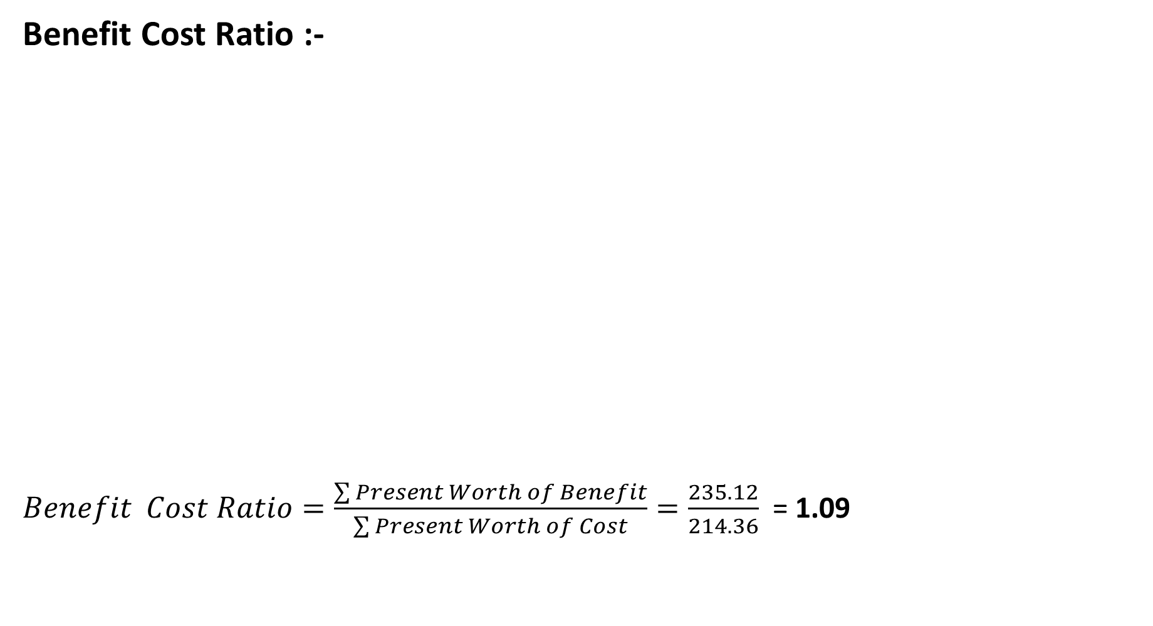
Benefit Cost Ratio :-
$Benefit Cost Ratio=\frac{\sum{Present Worth of Benefit}}{\sum{Present Worth of Cost}}=\frac{235.12}{214.36}$ = 1.09
Year | Total Cost (₹) | Gross Income(₹) | D.F.(14%) | PWC (₹) | PWB (₹)
2015-16 | 50.85 | 31.25 | 0.8771 | 44.60 | 27.40
2016-17 | 62.58 | 71.09 | 0.7694 | 48.14 | 54.69
2017-18 | 65.68 | 79.76 | 0.6749 | 44.32 | 53.83
2018-19 | 68.23 | 85.62 | 0.5920 | 40.39 | 50.68
2019-20 | 71.08 | 93.45 | 0.5193 | 36.91 | 48.52
 | 318.42 | 361.17 |  | 214.36 | 235.12

Slide 86
Internal Rate of Return :- (IRR)
Internal Rate of Return = Lower Discount Rate + Difference between two discount rate × NPW of lower discount rate
= 40 + (43-40) × [4.35/(4.35-3.36)]
= 40 + 3 × 4.39
= 40 + 13.18
IRR = 53 %
IRR is greater than market interest , hence the project is financially feasible and acceptable.
Sr.No. | Year | Net income(₹) | D.F.(40%) | D.F.(43%) | NPW @ (₹) 40% | NPW @ (₹) 43%
1 | 2015-16 | -19.33 | 0.7142 | 0.6993 | -13.80 | -13.51
2 | 2016-17 | 8.51 | 0.5102 | 0.4890 | 4.34 | 4.16
3 | 2017-18 | 14.11 | 0.3644 | 0.3419 | 5.14 | 4.82
4 | 2018-19 | 17.39 | 0.2603 | 0.2391 | 4.52 | 4.15
5 | 2019-20 | 22.37 | 0.1859 | 0.1672 | 4.15 | 3.74
Total |  | 43.05 |  |  | 4.35 | 3.36

Slide 87
Average Income = Net Benefit / No. of years
= 43.05 / 5
= 8.61₹
Pay Back Period = Initial Investment / Annual Net Cash Revenue
= 17.55 / 43.05
= 0.41
= 1 yr 4 month 28 days
Profitability Index = NPW / Initial Investment
= 20.76 / 17.55
= 1.18 ₹

Slide 88
SWOT Analysis :-
Strength : Good relation with suppliers . Loyal Customers. Free consultancy for customers. Trained , Qualified and experienced employees | Weakness : Poor Working environment. Less advertisement. Small Client List. Limited Services.
Opportunities : Usage of social media . Marketing Strategies reforms. Employee development. | Threats : Tax increases Existing competitors Changes in government policies. Changing Regulations Supplier.

Slide 89
Summary & Conclusion :-
Initial capital investment of krushiraaj agro-service centre is 17,55,300 ₹ .
Fixed cost and variable cost for agro-service centre is about 19,30,830 ₹ and 42,22,400 ₹ and hence ,total cost for all around year is 6153230 ₹
Net Present Worth of krushiraaj agro-service centre is 21.01 lakh ₹ .
Benefit Cost Ratio is 1.09 i.e. greater than 1 which shows that the selected agro service centre is financially feasible.
Internal Rate of Return of selected agro-service centre is 53 % . (By trial and error method) IRR is greater than market interest , hence the project is financially feasible and acceptable.
Pay Back Period is 1 yr 4 month 28 days .
Agro-service centre play important role in provide consultancy services to the farmers. They provide consultancy services to farmers on different factors like seed treatment, fertilizer application , disease and pest control and different farming practices for crops.

Slide 90
Experience Gained :-
Learnt the basics of how to manage an Agro-service centre and providing consultancy services.
Learnt how to help customers or farmers also how to interact with them.
Learnt about different documentation and procedure required while establishing a agro service centre.
Learnt that consultancy services are important to the farm and farmer for solving their problems.

Slide 91
Dr.D.Y.Patil College of
Agriculture Business Management
(AFFILIATED TO MAHATMA PHULE KRISHI VIDYAPEETH RAHURI)
STUDENT PROJECT WORK
MODULE – 4 Marketing Services for Farmers
NAME:-Sawant Vrushali Shankar
REGISTRATION NO.:- ABMP-2017/63
CREDIT:-0+4

Slide 92
Introduction :
Agricultural marketing covers the services involved in moving an agricultural product from the farm to the consumer. These services involve the planning, organizing, directing and handling of agricultural produce in such a way as to satisfy farmers, intermediaries and consumers. Numerous interconnected activities are involved in doing this, such as planning production, growing and harvesting , grading , packing and packaging , transport, storage, agro- and food processing, provision of market information, distribution, advertising and sale. Effectively, the term encompasses the entire range of supply chain operations for agricultural products, whether conducted through ad hoc sales or through a more integrated chain, such as one involving contract farming.
There are a number of strategies and tactics to help you improve not just your decision-making, but execution as well. Here are the top five agriculture marketing services that we've seen boost agribusiness revenue are market share , market segmentation, email marketing , programmatic advertising , sales integration.
There are different Marketing Services like Audit and accreditation,Commodity procurement ,Enforcement activity,Grain Inspection, Grain standardization , Grain official service provider ,Grants and opportunities ,lab testing and approval , Import / export certificates, Local food research and development ,Market and Facility Design , Market research and analysis , Organic Certification and accreditation , Perishable Agricultural Commodities Act , Pesticide Data Program , Plant Variety Protection , Quality grading and inspection , Seed Testing and clearance ,Transportation research and analysis, Warehouse Services
Meaning : Marketing is the process of persuading potential consumers to buy the organization's product or service. Marketing services are the methods used in the overall marketing plan of production, pricing, promotion and distribution.

Slide 93
Importance of Marketing Services for farmers :-
Marketing services and strategies are important because they make sales easier for any farmer. When you target your ideal customer in a smarter way, you reduce the costs of marketing and increase your chances of converting leads into sales. Asking what problem you solve and why customers should choose you helps you identify the specific issues of someone ready to buy.
Agricultural marketing plays an important role not only in stimulating production and consumption , but in accelerating the pace of economic development . Its dynamic functions are of primary importance in promoting economic development . For this reason it has been described as the most important multiplier of agricultural development . Agriculture provides raw material. The widening of the market helps in increasing the demand on a continuous basis and thereby guarantees a higher income to the producer . An improved and efficient system of agricultural marketing helps in the growth of agro-based industries and stimulates the overall development process of the economy.

Slide 94
Objectives :
To study the capital investment of marketing institute Assembling aspect of selected commodity.
To identify the appropriate packaging material, packaging size , packaging design, Grading aspect of selected commodity.
To study the marketing channels in selected institute.
To estimate channel wise marketing cost of selected commodity.
To study the SWOT analysis.
To study the Promotional strategies of selected commodity.
To study the problems and suggestion of marketing services for farmers.

Slide 95
Methodology :-
Selection of Commodity:-
The selected farmer cultivates various crop on the land but the following has been selected for the purpose of study,
• The crop is taken into consideration for study purpose was a seasonal crop that is onion and cucumber which he directly sales to market yard of khandala.
• There are cereals like jowar , bajra and wheat the farmer cultivates on the land which are sold to traders.
Address:- A/P-Khandala, T-Khandala, D-Satara P.C.-412802
2. Collection of Data:-
Primary Data:- Direct Interview through a well designed questionnaire with farmer.
Secondary Data:- For the purpose of this study, data was collected from Internet, Newspaper etc.

Slide 96
RESULT AND DISCUSSION

Slide 97
Marketing institution:
Public sector institution | Cooperative sector institution
Directorate of Marketing and Inspection (DMI) State Trading Corporation (STC) The Food Corporation of India (FCI) Cotton Corporation India (CCI) Jute Corporation India (JCI) Warehousing corporation (CWC,SWC) Agricultural processed products and export development agency (APEDA) Marine products export development agency (MPEDA) Expert Inspection Council Silk Export Promotion Council (SEPC) Agriculture Produce Market Committee (APMC) National Council of State Agricultural Marketing Board (COSAMB) | National Cooperative Development Corporation (NCDC) National Agricultural Co-Operative Marketing Federation (NAFED) National dairy development board (NDDB) National oilseeds and vegetable oils development board (NOVOD) National Cooperative Tobacco Growers Federation (NTGF) National Consumers Cooperative Federation (NCCF) Tribal Cooperative Marketing Federation (TCMF) State Cooperative Marketing Federation (SCMF) Primary Agricultural Cooperative Marketing Societies (PACS)

Slide 98
Role and Functions of marketing institutions:
Framing rule and regulation for the protection of the interest of some sections of the population. These may relate to the grant or restrictions of monopolies, restriction on the activities of traders licensing and market regulation.
Establishment of organization, to provide services to the farmers for performing certain marketing functions.
Promotion of farmers cooperative societies for agricultural marketing and agro processing.
Creating of market infrastructure such as storage, warehousing, transportation and communication facilities, credit facility, grading and standardization.
Administration of prices at different levels of marketing- guaranteeing minimum support prices to producers, providing commodities at fair prices to consumers, and mixing the rates of commission charged by commission agents.
Influencing supply and demand by regulating import, internal procurement and distribution.

Slide 99
Direct selling:
Direct selling is an effective way to grow a flexible, low-cost business. Direct selling involves an independent salesperson selling products or services directly to customers, often at a customer's home or workplace. Traditional direct selling methods include door-to-door sales, party plans and network marketing.
Types :-
Person-to-person sales
Door-to-door sales
In-home presentations
Online shopping venue sales network marketing
Indirect selling:
Indirect sales are performed with the help of intermediaries. There is no personal contact between the seller and the buyer. This type of sales is a widespread practice in email marketing.
Types :-
Distribution
Merchandising
Franchising
Dealership

Slide 100
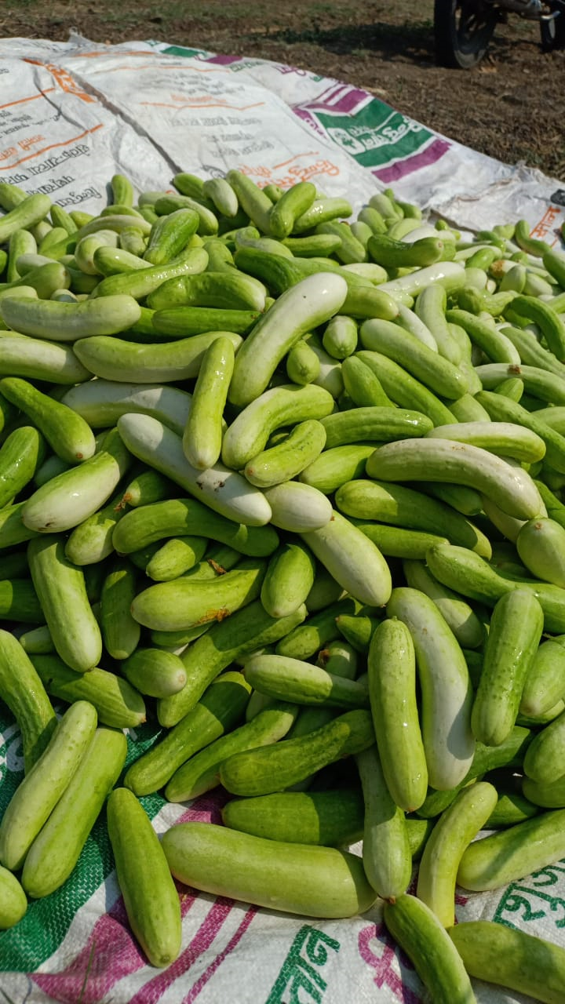
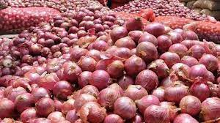
Information of the Farmer
Name of Host Farmer | Sadashiv Hanmant Khandagle
Age | 53
Education | 12th
Category of host farmer | Small land holding (0.80ha)
Address | A/P Khandala , T- Khandala , Satara
Commodity of host farmer | Cucumber , Onion
Variety | Cucumber – Namdhari 46 Onion – local variety

Slide 101
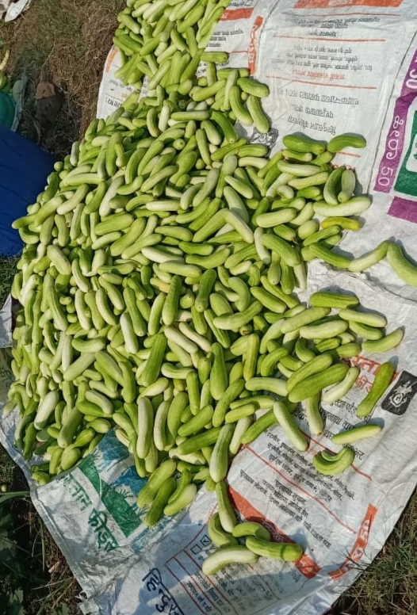
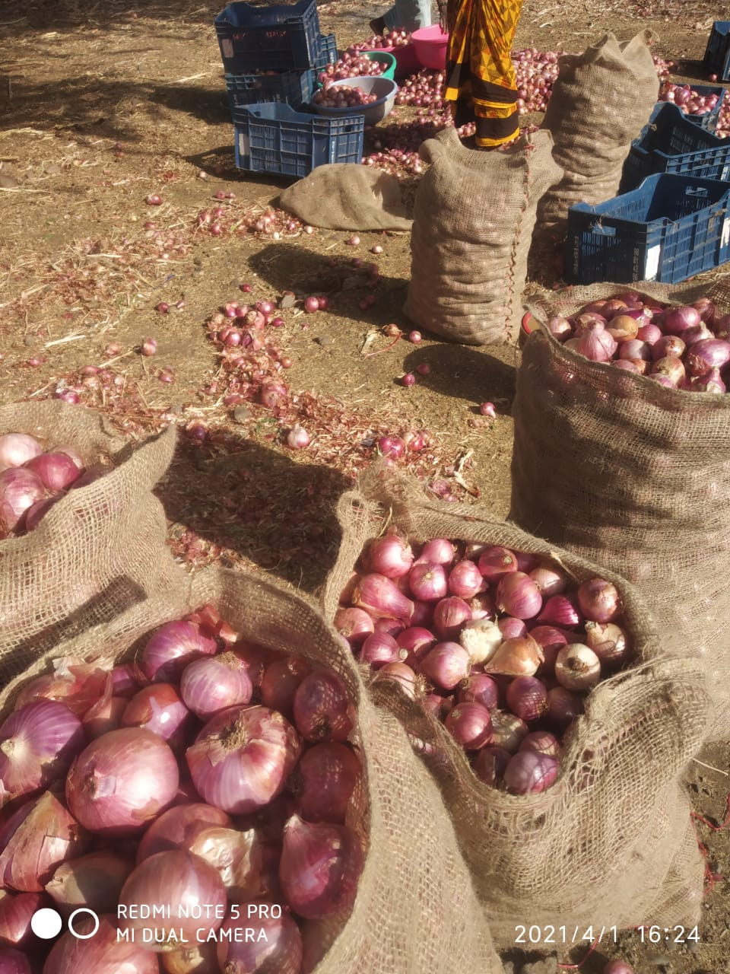
Assembling
• Collection of produce for sale in mandis or larger markets is called Assembling.
Assembling of Cucumber - Assembling of Cucumber is done at the field of farmer
Assembling of Onion- Assembling of Onion is done at the field of the farmer .

Slide 102
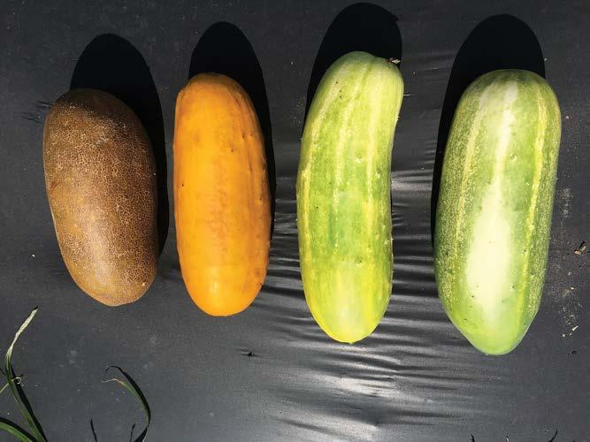
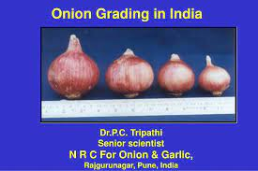
Grading of Cucumber:
Cucumbers must be sorted according to their diameter and length, and selected according to shape too. The minimum diameter of each cucumber shall be not less than 2-1/4 inches and, unless otherwise specified, the length of each cucumber shall be not less than 6 inches. There are no maximum diameter and length requirements.
Grading of Onion:
The onion bulbs are classified into three grades based on bulb size i.e. A (> 80 mm), B (50-80 mm) and C (30-50 mm) grades. In India, grading of onion is usually performed manually either before storage or before marketing.

Slide 103
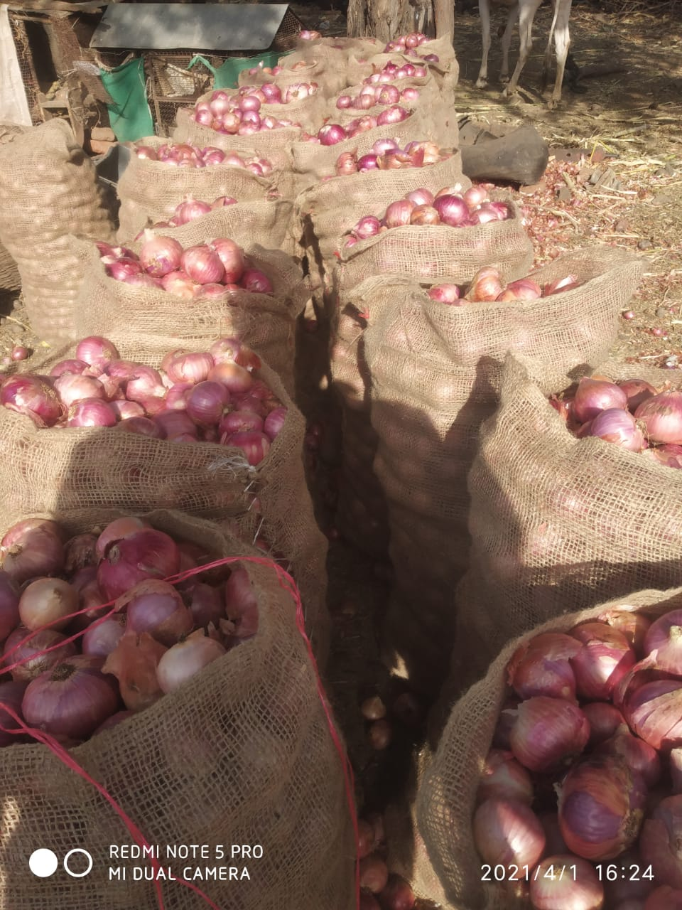
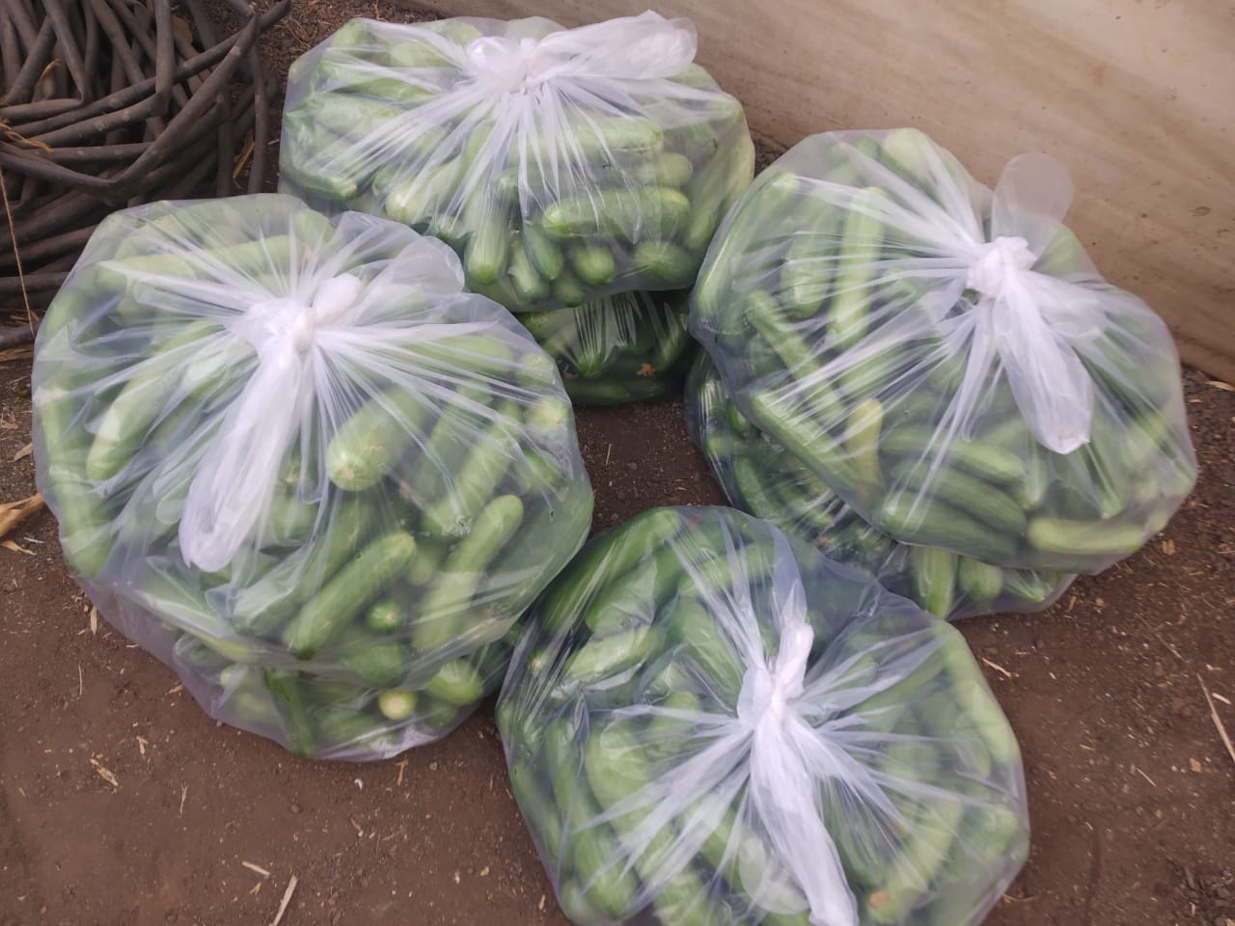
Packaging:
Packaging is the science, art and technology of enclosing or protecting products for distribution, storage, sale, and use. Packaging also refers to the process of designing, evaluating, and producing packages. Packaging can be described as a coordinated system of preparing goods for transport, warehousing, logistics, sale, and end use. Packaging contains, protects, preserves, transports, informs, and sells.

Slide 104
Study of appropriate Packaging materials :-
Packaging material for Cucumber :-
Packaging material for Onion :-
Sr.No. | Packaging material | Quantity (bags) | Rate (₹) | Amount(₹)
1. | Plastic bags | 500 | 10 | 5000
Sr.No. | Packaging material | Quantity(bags) | Rate (₹) | Amount (₹)
1. | Gunny bags | 30 bags | 35 per bag | 1050
2. | Twine | 250gm | 25 | 25
Total |  |  |  | 1075

Slide 105
Study of appropriate Packaging Size :
Packaging size for cucumber :-
Packaging size for Onion :-
Sr.No. | Grade | Packaging size (kg) | Quantity (bags)
1. | A | 10 | 350
2. | B | 10 | 150
Sr.No. | Grade | Packaging size(kg) | Quantity (bags)
1. | A | 50 | 25
2. | B | 50 | 3
3. | C | 50 | 2

Slide 106
Registration of brand :
Step by step procedure to register a brand
Step 1: To search for a brand
Step 2: To file the brand application form
Step 3: Examination of the brand application by the government authority
Step 4: Post- examination
Step 5: Advertisement of the brand
Step 6: Registration certificate
Step 7 : Renewal
Documents required for other applicants in a trademark registration
All other applicants, including companies that do not have Udyog Aadhar registration will have to submit the following documents to obtain trademark registration in India.
Scanned copy of the logo (optional)
Duly signed Form- 48
The Incorporation Certificate
Copy of identity proof of signatory/ applicant
Copy of address proof of signatory/ applicant

Slide 107
Transportation facility :
Transportation facility means any road, bridge, tunnel, overpass, ferry, airport, mass transit facility, vehicle parking facility, port facility, or similar commercial facility used for the transportation of persons or goods, together with any buildings, structures, parking areas, appurtenances, and other property needed to operate such facility; however, "transportation facility" does not include a commercial or retail use or enterprise not essential to the transportation of persons or goods.
Transportation of Onion and Cucumber is done by farmer with the help of Tempo , Truck and Pick-up.

Slide 108
Promotional strategies –
A promotion strategy is an actionable plan to influence people about your business, generate more leads, and boost customer engagement. It visualizes how to perform your marketing strategy and communication, who to target as your audience, and where and when to execute the promotion plan.
Traditional advertising
Direct marketing
Giving sample
Word-of-mouth marketing
Personal (face-to-face) selling

Slide 109
Marketing channels for cucumber
Marketing Channels for Onion :-
Farmer
Retailer
Consumer
Farmer
Retailer
Consumer

Slide 110
Channelswise marketing cost :-
Sr.no. | Particulars | Rate(₹) / kg Onion | Rate(₹) / kg Cucumber
a) Cost incurred by farmer
1 | Production cost | 10 | 15
2 | Packaging cost | 2.71 | 1.94
3 | Transportation cost | 0.13 | 0.2
4 | Storage cost | 0.1 | 0.1
5 | Loading | 0.13 | 0.3
 | Subtotal | 13.07 | 17.54
Farmer selling price & Retailer purchasing price |  | 15 | 20
b)Cost incurred by Retailer
1 | Transportation cost | 1 | 1
2 | Storage ,grading, loading cost | 0.66 | 1.4
3 | Market fee | 1 | 1
 | Subtotal | 2.66 | 3.4
Retailer selling price & consumer purchasing price |  | 20 | 30
Total marketing cost |  | 15.73 | 20.94

Slide 111
Farmer margin = Selling price – Cost incurred by farmer (onion) = 15 – 13.07 =1.93 ₹
Farmer margin = Selling price – Cost incurred by farmer (cucumber) = 20 – 17.54 =2.46 ₹
Retailer margin = Selling price – (Cost incurred by Retailer + Purchase price ) (onion) = 20 – (2.66+15) =2.34 ₹
Retailer margin = Selling price – (Cost incurred by Retailer + Purchase price ) (cucumber) = 30 – (3.4+20) =6.6 ₹

Slide 112
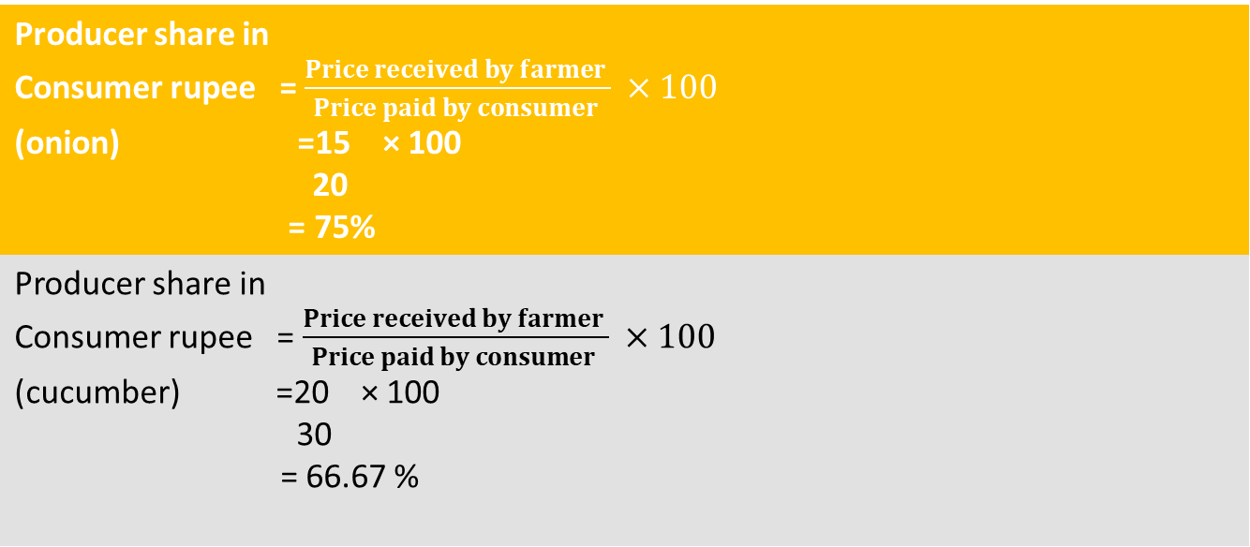
Price Spread = Price paid by consumer – Price received by producer (onion) = 20 – 15 =5 ₹
Price Spread = Price paid by consumer – Price received by producer (cucumber) = 30 – 20 =10 ₹
Producer share in Consumer rupee = $\frac{Price received by farmer }{Price paid by consumer } ×100$ (onion) =15 × 100 20 = 75%
Producer share in Consumer rupee = $\frac{Price received by farmer }{Price paid by consumer } ×100$ (cucumber) =20 × 100 30 = 66.67 %

Slide 113
Suggesting Online marketing for cucumber and onion
Why Choose this Method to Sell Onions and cucumbers Online?
No need to pay commission on any of our sale.
Multiple payment options like PayPal, Credit Card, etc to collect payment from a single place.
Collect payments & sale products in any currency as per customers requirement.
Give discounts on your products by offering special coupon codes.
How to Sale Onions and cucumber Online (step by step)
1. Signup & Login
2. Select Subscription Billing
3. Account Setup
4. Connect Payment Gateway
5. Add Your Product
6. Add Plans
7. Share your Checkout Page
8. Preview Checkout Page
9. Embed on a WordPress Site
10. Multiplan Checkout Page

Slide 114
SWOT Analysis :-
Strengths Good quality product . Fertile land. | Weakness Lack of investment. Basic grading practices.
Opportunity Have the ability to develop new product . Growing local & regional demand. Use of social media . | Threats Seasonal market demand Natural calamities.

Slide 115
Problems in agricultural marketing services for farmer
Problems | Suggestions
No direct contact with customer . | Use promotional strategy like online marketing.
Lack of Market Information | Farmer get information from various sources like whatsapp groups, Agriapp, IFFCO Kisan app.
Basic grading practices followed . | Farmer should perform grading according to the standard norms.
Bulky nature of packaging commodity. | Proper Packaging of commodity helps taken to various market.
Presence of middlemen | Eliminating middlemen in market .
Low marketable surplus of Agricultural goods | Use of intensive farming , and use of advanced farming techniques.
Inadequate Credit Facilities | Use of different Government credit policies and schemes . eg. KCC

Slide 116
Summary and Conclusion :-
Packaging and transportation facility prevents the post harvest loses of commodity.
Study Marketing channels for onion and cucumber.
Channel wise marketing cost of onion and cucumber is about 15.73 ₹/kg & 20.94₹/kg.
Study the registration process for brand and documents required for branding.
Different marketing activities helps to add value to the commodity and increasing farmers income.

Slide 117
Experience Gained :
Learned various methods of marketing of onion and cucumber.
Learned how to done packaging for onion & cucumber and learn about norms of grading.
Learned the various ways of marketing of commodities through promotional strategies.
Learnt about different marketing services which are helpful for increase income of farmer.
Learned various problems faced by farmer during marketing and give suggestion to overcome them.

Slide 118


Dr. D.Y. Patil College Of
Agriculture Business Management
Akurdi , Pune-44
STUDENT READY PROGRAM
2020-2021
MODULE 4 :Entrepreneurial Development Programme
Presented by : SAWANT VRUSHALI SHANKAR
ABMP – 2017/63

Slide 119
CAREER OPPORTUNITIES IN AGRICULTURE BASED ENTERPRISE
Expert : Mrs. Swati Shingade
Agri Entrepreneur , Baramati , Pune
Points covered :
Information about organic farming .
Information regarding Training programs and workshops
Scope of agricultural entrepreneurship
Information about Hi-tech farming and floriculture .
Shared personal experiences .

Slide 120
EXPERT LECTURE ON CAREER OPPORTUNITIES IN EXPORT AND IMPORT OF AGRICULTURE PRODUCE .
Expert : Mr. Sunil Shinde.
Founder , Grape Master Consultancy , Nashik .
Points Covered :
Present scenario of Agri advisory services
Scope of advisory services .
Importance .
Documentation required for import and export .
Business opportunities .
Information of grape master .

Slide 121
ENTERPRENEURSHIP OPPORTUNITIES IN POULTRY SECTOR
Expert : Shri. Shrikrushna Gangurde
Director , Avee broilers , Nashik
Points covered :
Introduction of poultry
Present scenario of poultry in India
Scope and importance of poultry
Success story of Avee broilers .

Slide 122
FUNDING SPONSORING AGENCIES FOR AGRI-ENTREPRENEURS
ESTABLISHMENT
Expert : Mr. Ulhas bhale
Director , UDYAM info solution Pvt. Ltd. , Aurangabad .
Points covered :
Introduction of Agri-based enterprises.
Subsidies provided under Central Government Scheme.
Subsidies provided under State Government Scheme.

Slide 123
PLACEMENT AND ENTERPRENEURSHIP OPPORTUNITIES IN DAIRY SECTOR
Expert : Dr. Prakash Aute
Zonal head , fresh product , Amul Western region , Mumbai .
Points covered:
Review on Agriculture and allied sector.
Sector wise review on Indian economy.
Review on Dairy sector
Agri allied opportunities .

Slide 124
JOB OPPORTUNITIES FOR PLACEMENT AND ENTREPRENEURSHIP IN ENVIRONMENTAL HORTICULTURE .
Expert : Mr. Devendra Jagtap
CEO , Jagtap Horticulture , Pvt. Ltd. , Pune
Points covered :
Introduction about Horticulture .
Scope and importance
Nursery Planning techniques .
Information about exotic plants and species .

Slide 125
CAREER OPPORTUNITIES IN AGRO-PROCESSING
Expert : Dr. N. J. Thakor
Former dean , Faculty of Agriculture Engineering , Dr. BSKKV , Dapoli
Points covered :
Concept of Agro-processing .
Importance and scope of Agro-processing sector .
Opportunities in Agro-processing sector .
Information about Milk, fishery and fruit crop production .
Review on processed food trade .
Key challenges in Agro-processing sector .

Slide 126
EMPLOYEMENT OPPORTUNITIES IN AGROCHEMICAL BUSINESS
Expert : Mr. Narendra Rane
Chief operating officer , Indofil industries , Mumbai
Points covered :
Introduction of Agro-chemical Industry
Use of technology in Agriculture
Global Investment .
Global crop protection performance , 2020
Job opportunities in Agro-chemical market .

Slide 127
BUSINESS DEVELOPMENT SKILLS
Expert : Dr. Vikram Kajale
CEO , Life and business coach , Nashik
Points covered :
Introduction of business development skills
Importance of business development skills
Advice for new plans and strategies for business development .

Slide 128
OPPORTUNITIES FOR AGRI- GRADUATES IN FOREST SECTOR
Expert : Dr. Shailendrakumar Jadhav
Additional Director (Administration) Kunal academy , development
administration and management (Forest) , Sangli.
Points covered :
Introduction of forestry
Branches of forestry
Importance of forestry
Government job opportunities in forestry
Indian forest services exam pattern and syllabus
Roles and responsibilities of an IFoS Officer .

Slide 129
The above series of lectures were arranged and attended on online platform , Lectures were very informative and highly inspiring especially to one’s who are aspiring to be a Agri-entrepreneur . The experts were specialized and experienced in their respective fields and guided the students very well regarding each and every aspect of their fields .
These series of lectures will surely help the students to progress in their forthcoming future.

